Slide 1


Interpretable Model Augmentation for a
High-Precision Dual-Gantry Motion System
Dirk van den Berg | MSc thesis, TU/e Control Systems, with ASMPT
Supervisors: M. Schoukens, R. Tóth, J. Hoekstra
Notes:
• Dirk, graduation project ASMPT, TU/e Control Systems • physics model + neural network = model augmentation • augmentation → accuracy (easy part) • interpretable → parameters keep their meaning (hard part) • route: why a model → machine + physics model → augmentation + results → interpretability

Slide 2

ASMPT builds the machines that assemble chips
ASMPT
semiconductor assembly and packaging equipment
Photo placeholder
INSIDE
fast, high-precision motion systems
An ASMPT assembly machine, ideally with its gantry visible (for example an ASMPT press image)
THIS PROJECT
a dual-gantry motion system
2
Interpretable model augmentation | Dirk van den Berg
Notes:
• ASMPT: equipment that assembles and packages chips • [click] inside: motion systems, fast and precise • precision → you need to understand the dynamics → models • [click] my project: one such system, a dual gantry • (photo: point at the gantry)

Slide 3
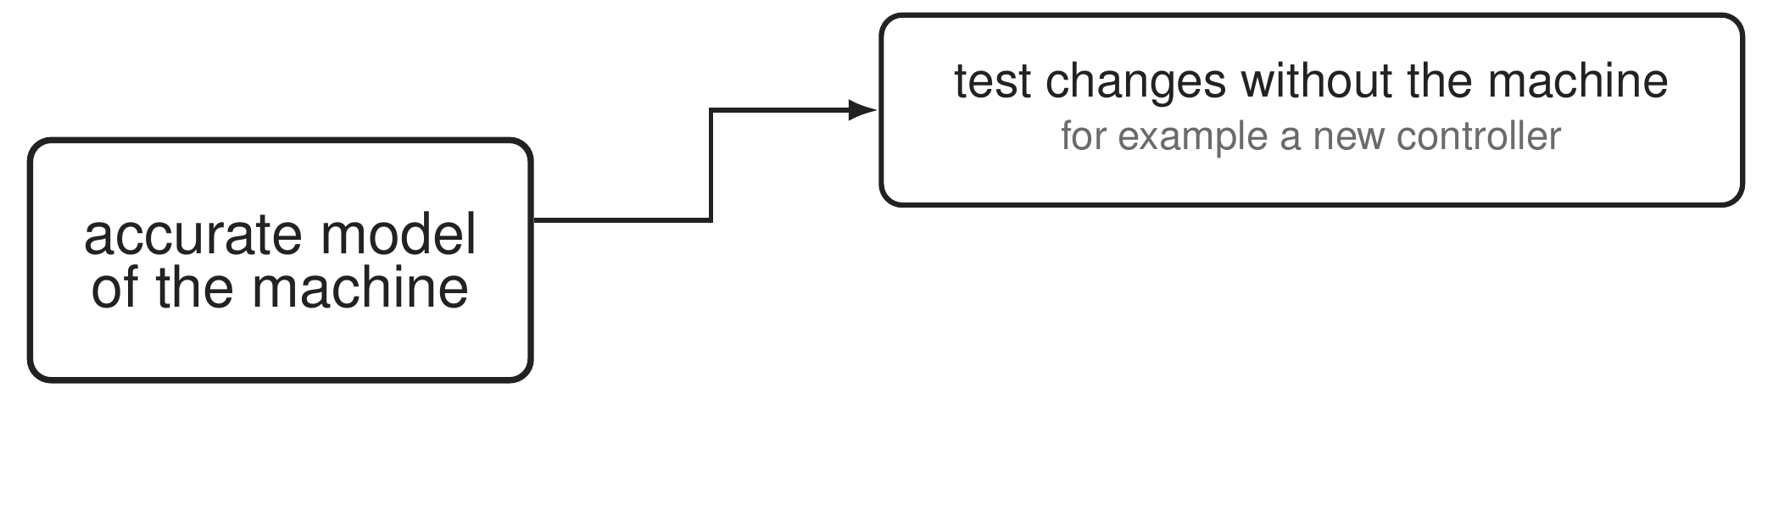
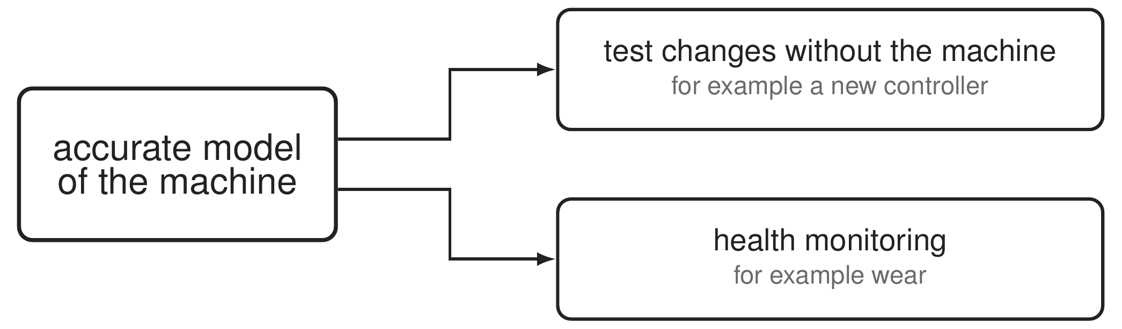
Why a model of the machine is useful
3
Interpretable model augmentation | Dirk van den Berg
Notes:
Why would ASMPT want a model of the machine? Because with an accurate model, engineers can try changes without the real machine. A new controller is one example: test it on the model before it runs on the machine. [click] A second use is health monitoring. If the model's parameters are physical, masses, stiffnesses and dampings, then a change in those parameters over time says something about the machine, for example wear. Both need an accurate model, and the second one also needs parameters that mean what they say. That comes back later.

Slide 4
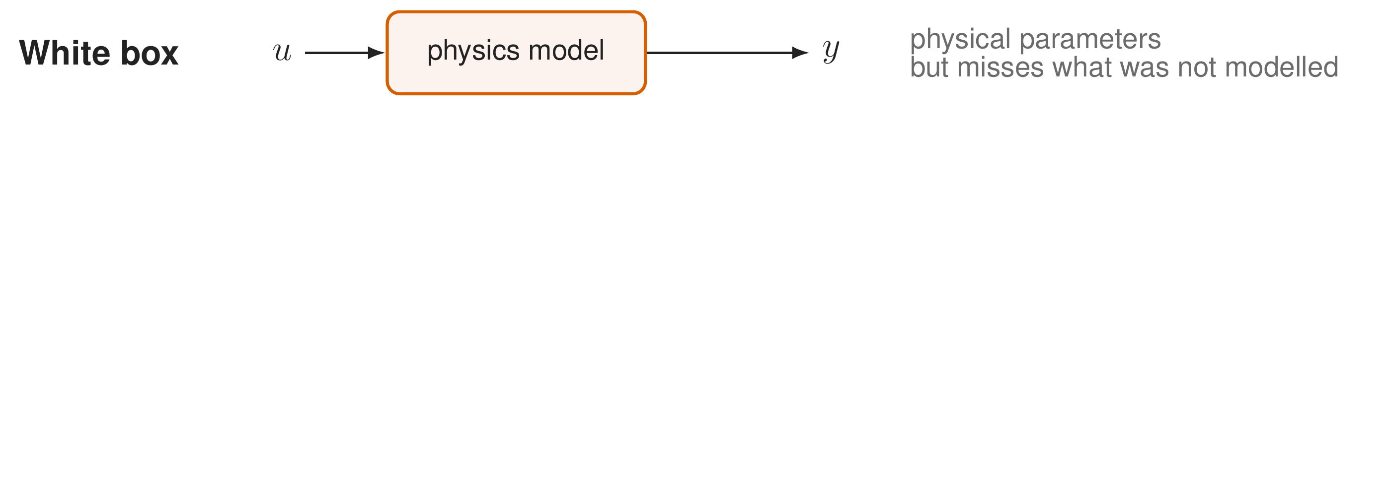
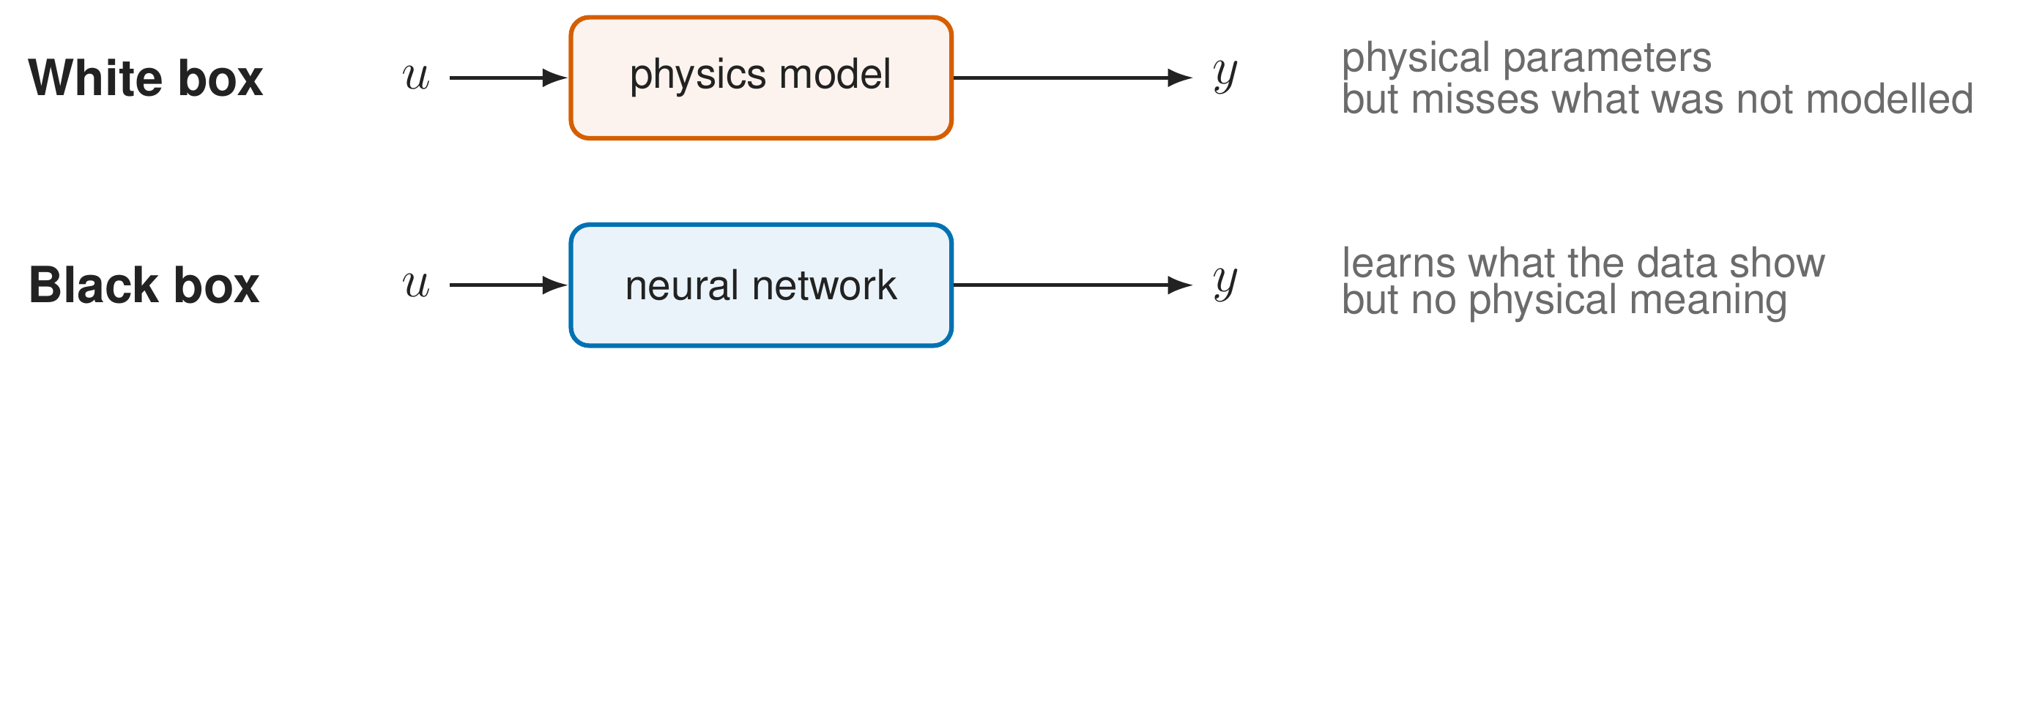
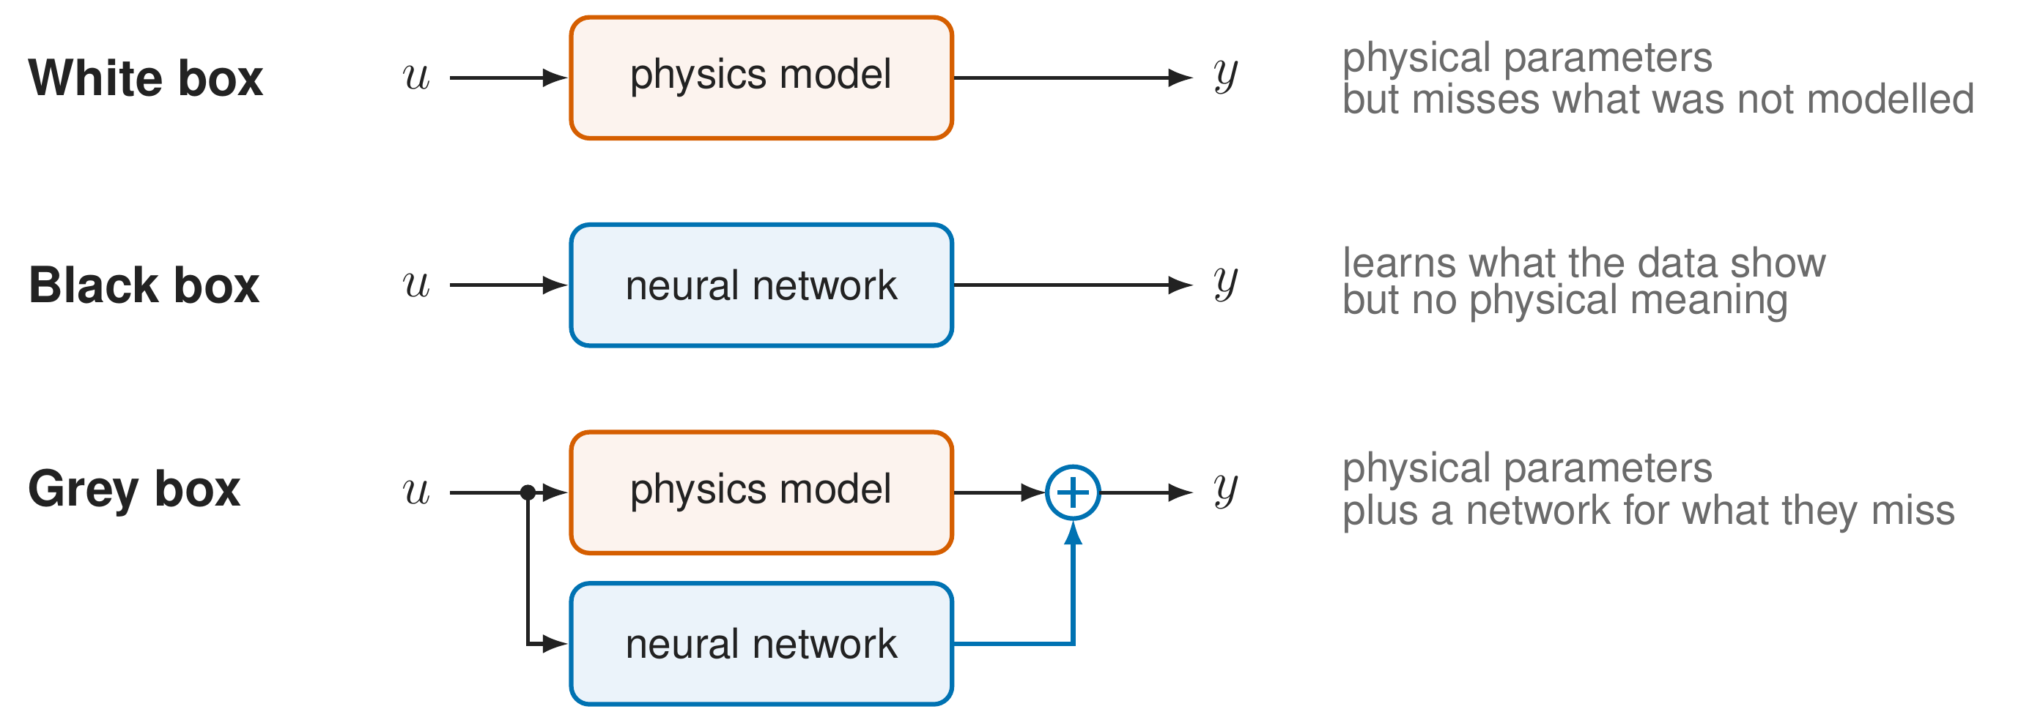
Three ways to model the machine
4
Interpretable model augmentation | Dirk van den Berg
Notes:
There are roughly three ways to get such a model. A white box model comes from physics: its parameters are masses, stiffnesses and dampings, but it misses whatever nobody put in it. [click] A black box model learns everything from data. It captures what the data show, but its parameters have no physical meaning, and it usually needs more data. [click] A grey box model keeps the physics model and adds a network for what the physics misses. That is what I do; adding a network to a physics model this way is called model augmentation.

Slide 5
Goal of the project
Accurate
learn the dynamics the physics model misses
Interpretable
the physical parameters keep their meaning
5
Interpretable model augmentation | Dirk van den Berg
Notes:
So the goal has two parts. Accurate: the augmented model should capture the dynamics the physics model misses. [click] Interpretable: the physical parameters in the model should still mean mass, stiffness and damping, also when we train them together with the network. The first part is the method and results in the first half of the talk; the second part is the second half.

Slide 6
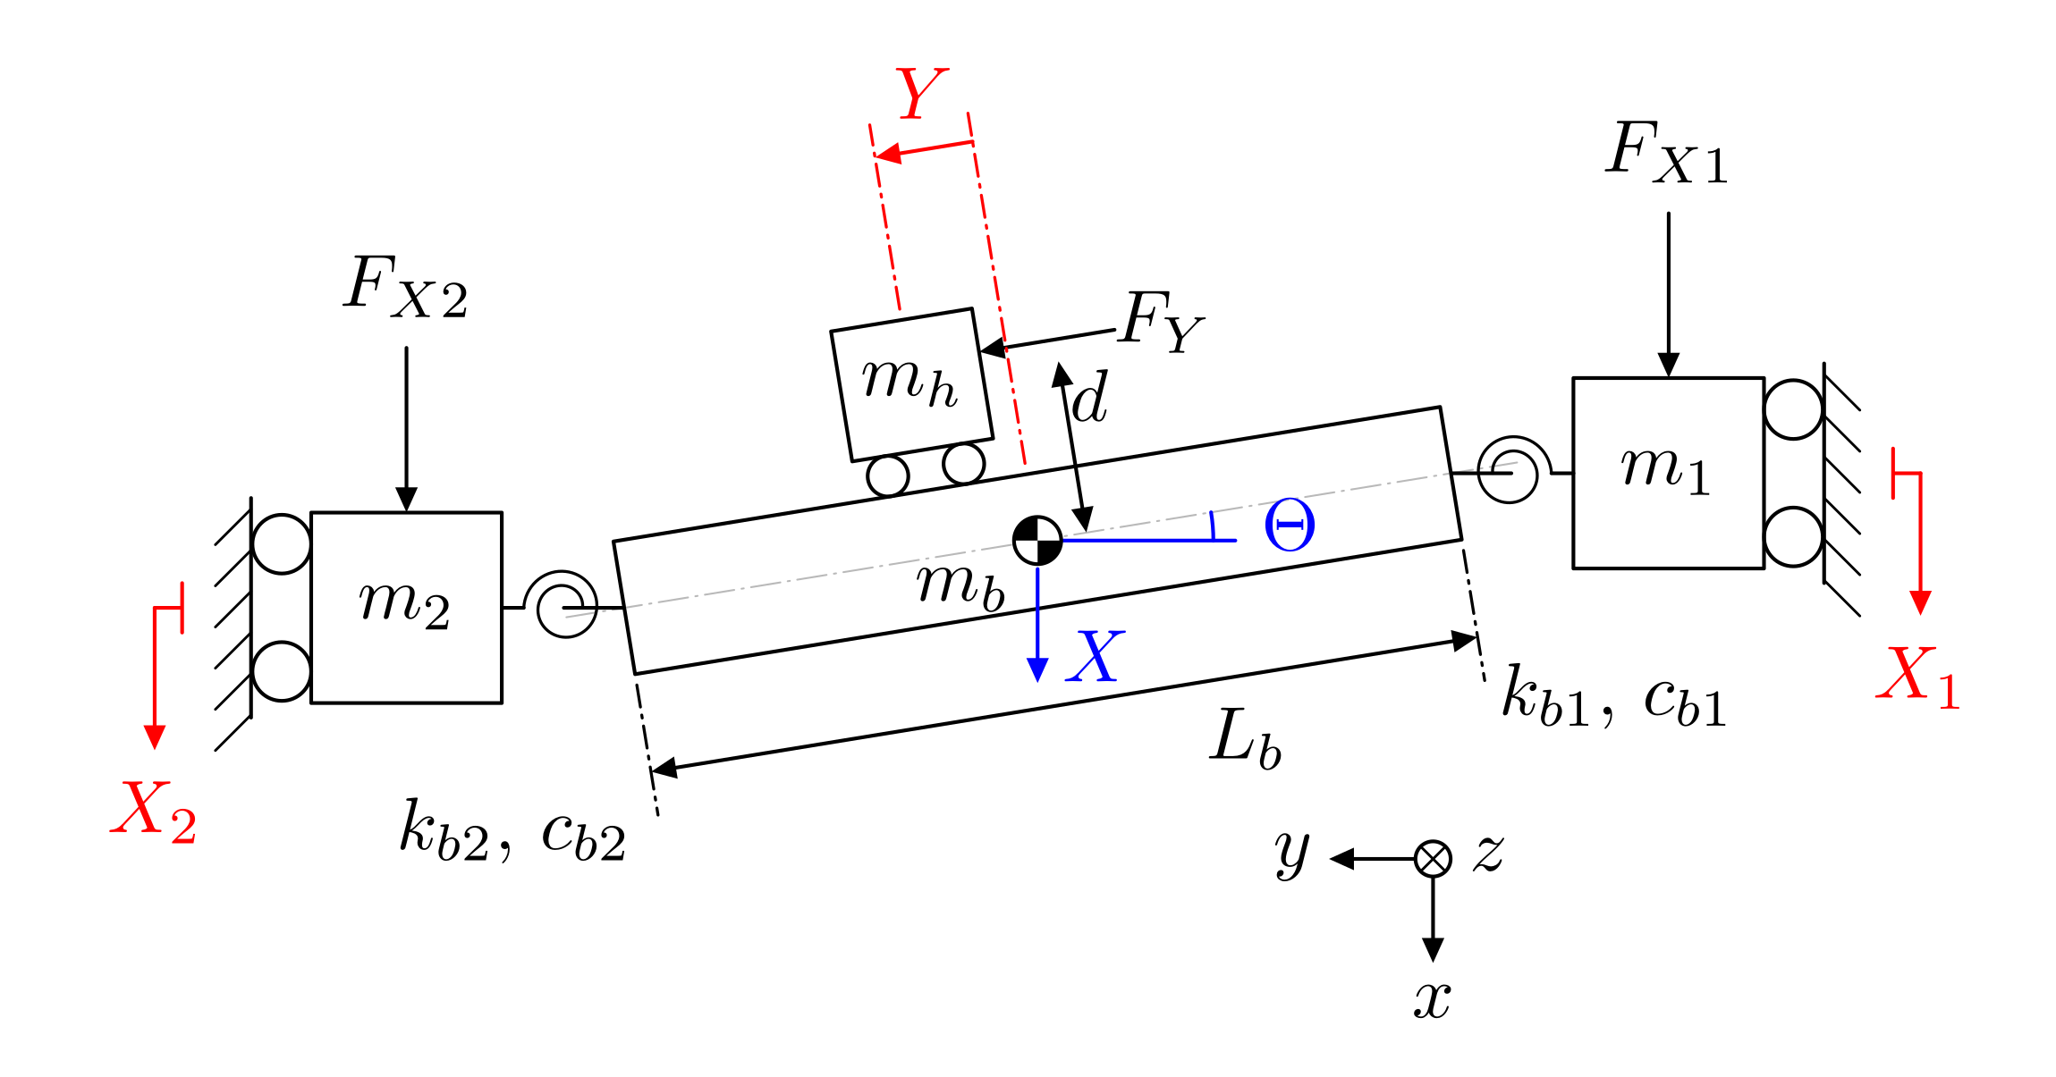
The machine: a dual-gantry motion system
Two parallel drives carry a cross-arm, a third drive moves the payload along it
6
Interpretable model augmentation | Dirk van den Berg
Notes:
This is the machine. Two parallel linear drives, X1 and X2, carry a cross-arm. Because the two drives can move slightly differently, the cross-arm can rotate a little: that is the yaw angle Theta, resisted by the flexible joints. A third drive moves the payload along the cross-arm, in Y. So the physics model has three coordinates: X, Theta and Y.

Slide 7
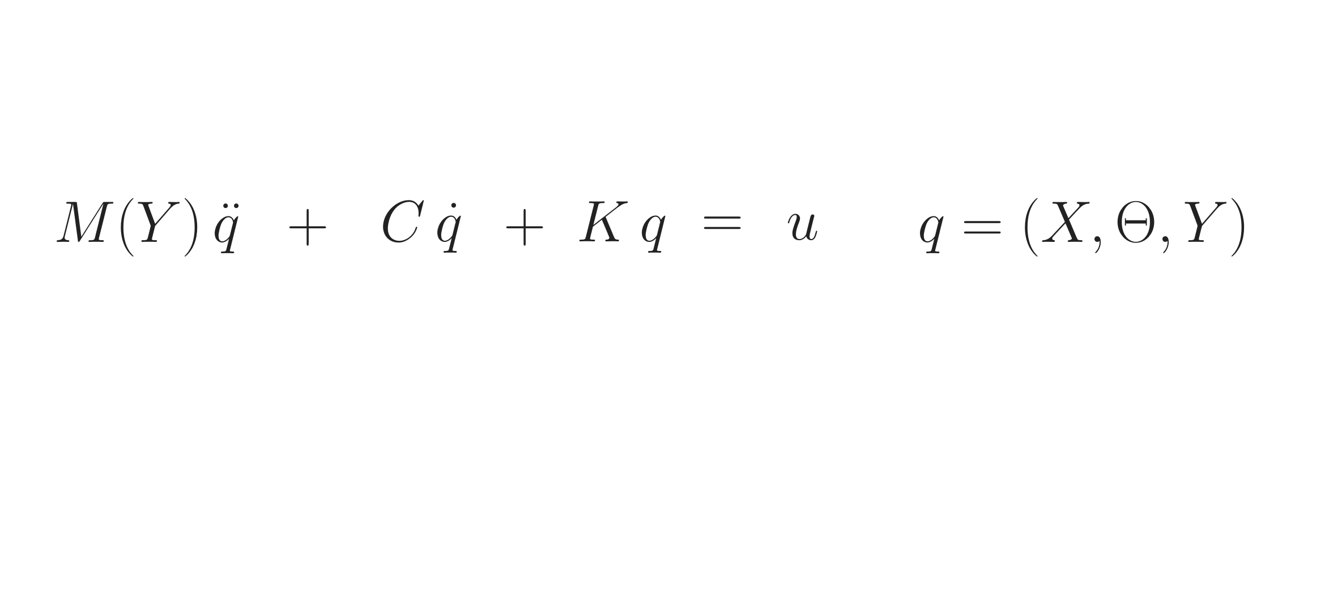
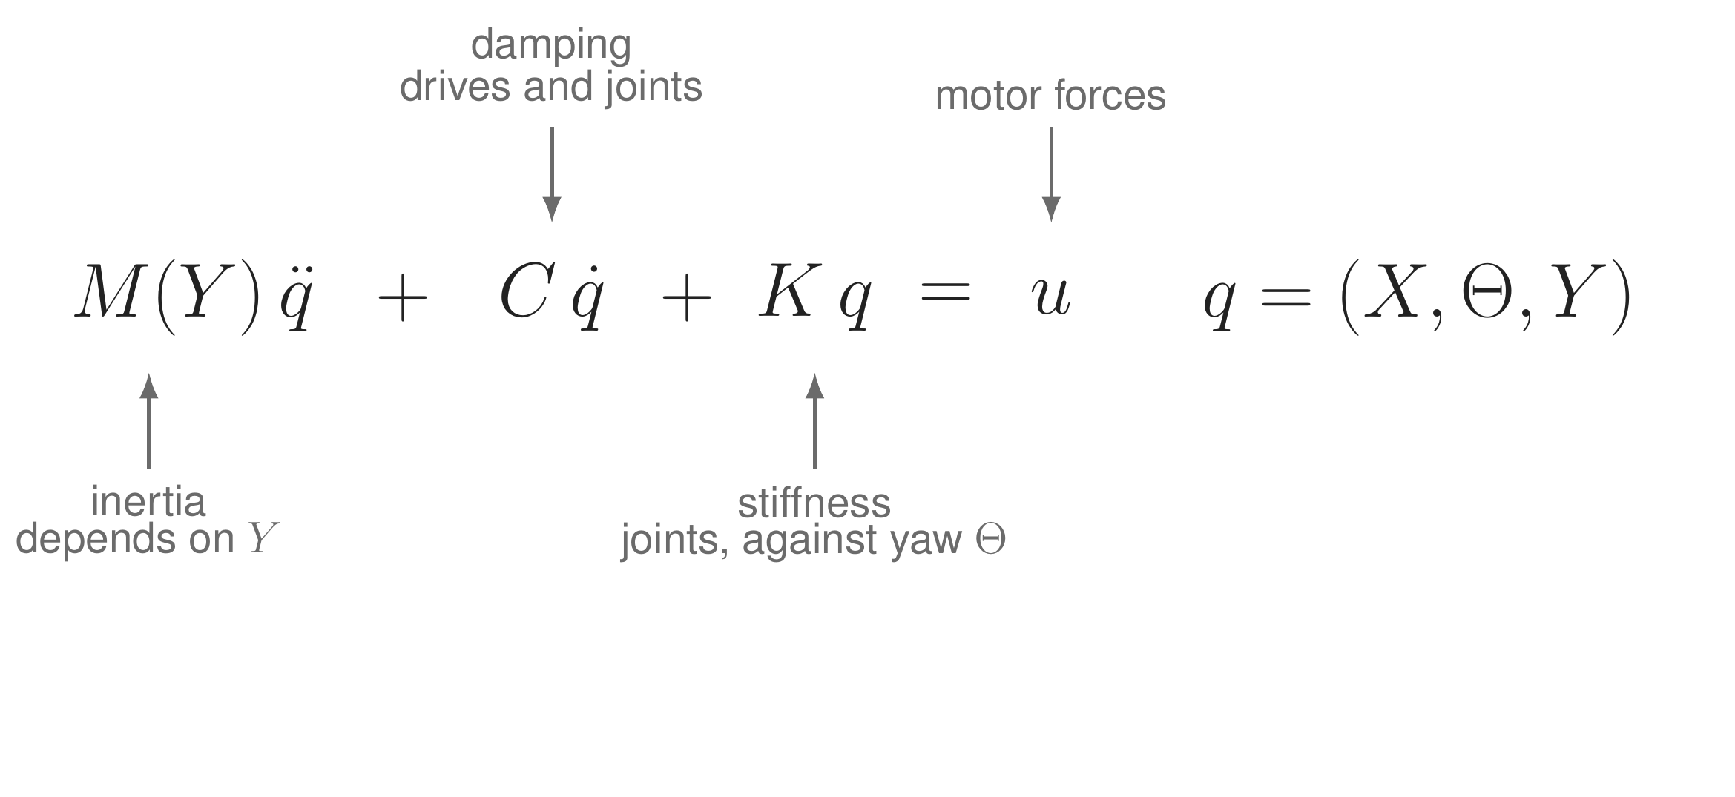
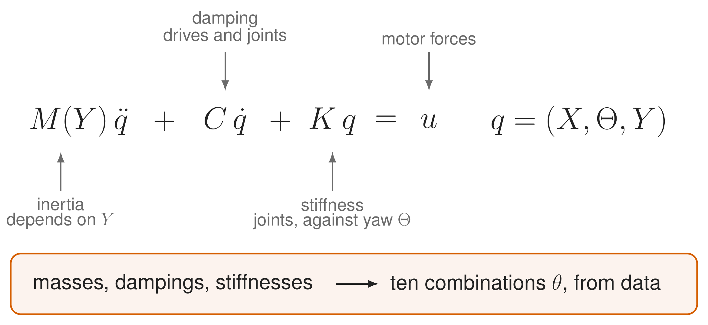
Our baseline: the physics model
7
Interpretable model augmentation | Dirk van den Berg
Notes:
This is the baseline physics model, from Garcia-Herreros and colleagues. The three coordinates X, Theta and Y from the previous slide are collected in q; with positions and velocities that gives six states. [click] M of Y is the inertia; it depends on where the payload is, because moving the payload moves mass along the cross-arm. C is the damping in the drives and the flexible joints. K is the stiffness, only in the joints, against yaw. u are the three motor forces. [click] The physical parameters are the masses, dampings and stiffnesses. From input and output data we cannot identify each of them separately, but we can identify ten combinations, for example only the sum of the two joint stiffnesses. These ten, theta, are the physical parameters I mean for the rest of the talk, and they are what should keep their meaning.

Slide 8
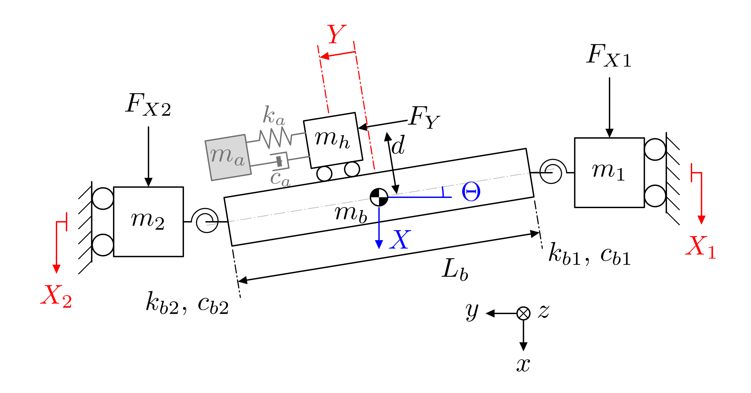
In simulation, the machine has something extra
Half of the 10.1 kg payload on a spring and damper: a resonance at 212 Hz
physics model: 6 states | simulated machine: 8 states
8
Interpretable model augmentation | Dirk van den Berg
Notes:
To test the method where we know the truth, I use a simulated machine. [click] It has one thing the physics model does not have: half of the 10.1 kilogram payload hangs on a spring and damper, the grey part. [click] That gives a resonance at 212 hertz. [click] The physics model has six states, the simulated machine eight. So the augmentation has to find two missing states, from input and output data only. This is what we want the network to capture.

Slide 9
Data from the simulated machine
14
4
12 s
140 to 230 Hz
training records
held-out records
per record, at 4 kHz
excitation, covers 212 Hz
Noiseless, with the controller in the loop, as the machine always runs
9
Interpretable model augmentation | Dirk van den Berg
Notes:
The data. 14 training records and 4 held-out records that are never used for training, each 12 seconds at 4 kilohertz. The excitation covers 140 to 230 hertz, so it covers the hidden resonance. The data are noiseless for now, and recorded with the controller in the loop, because the machine always runs under feedback: in X and Y there is no spring to the ground, so without a controller it would drift.

Slide 10
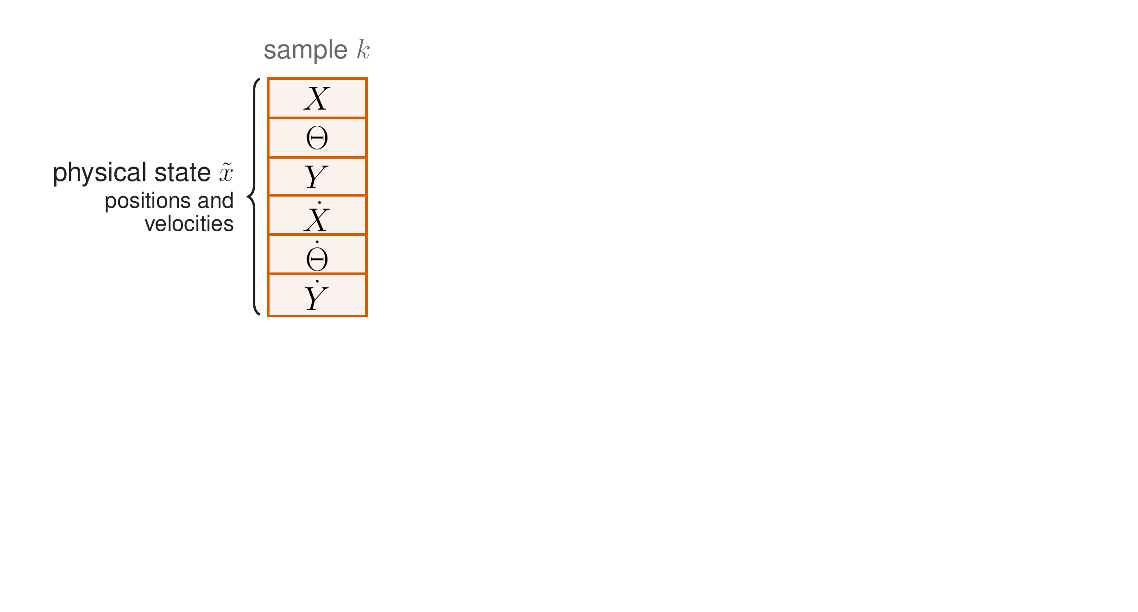
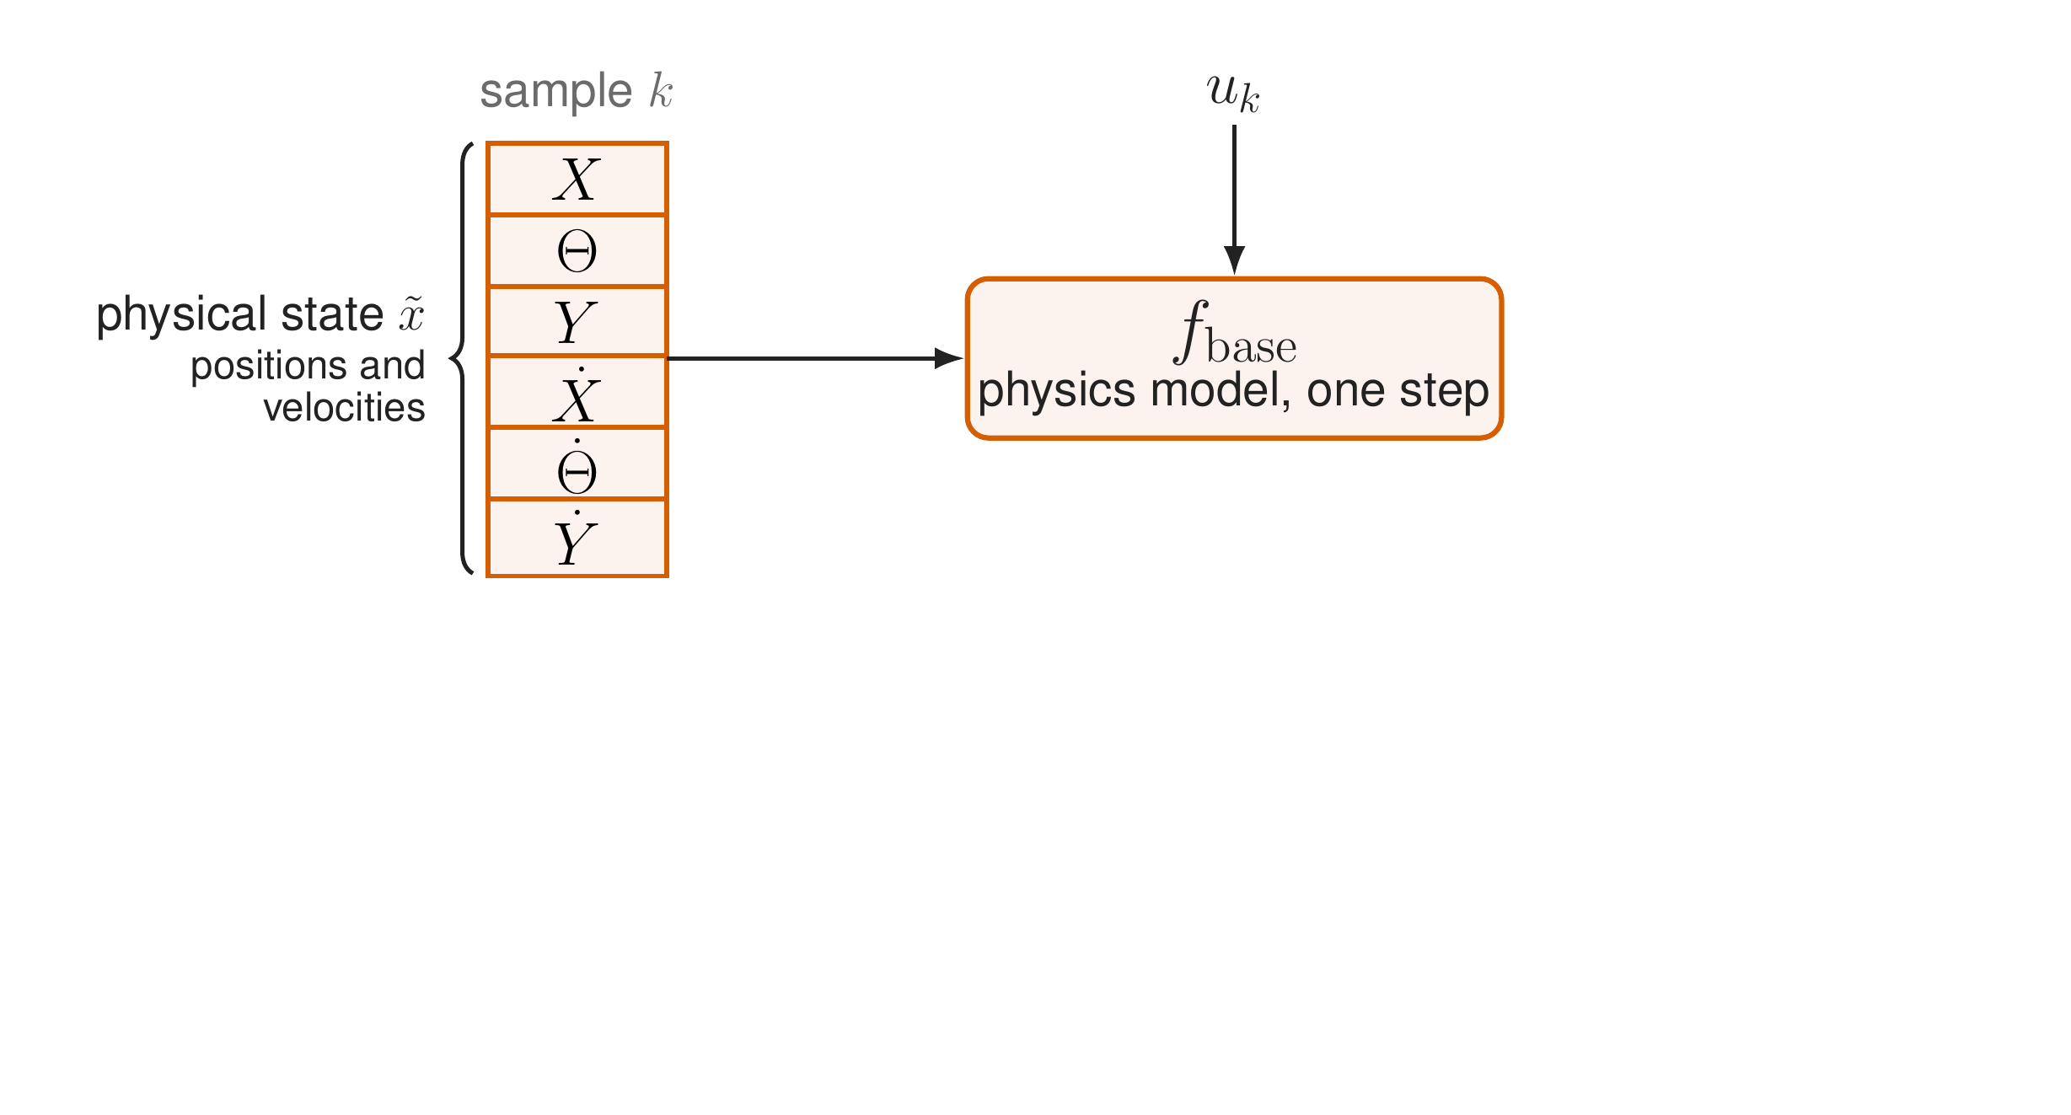
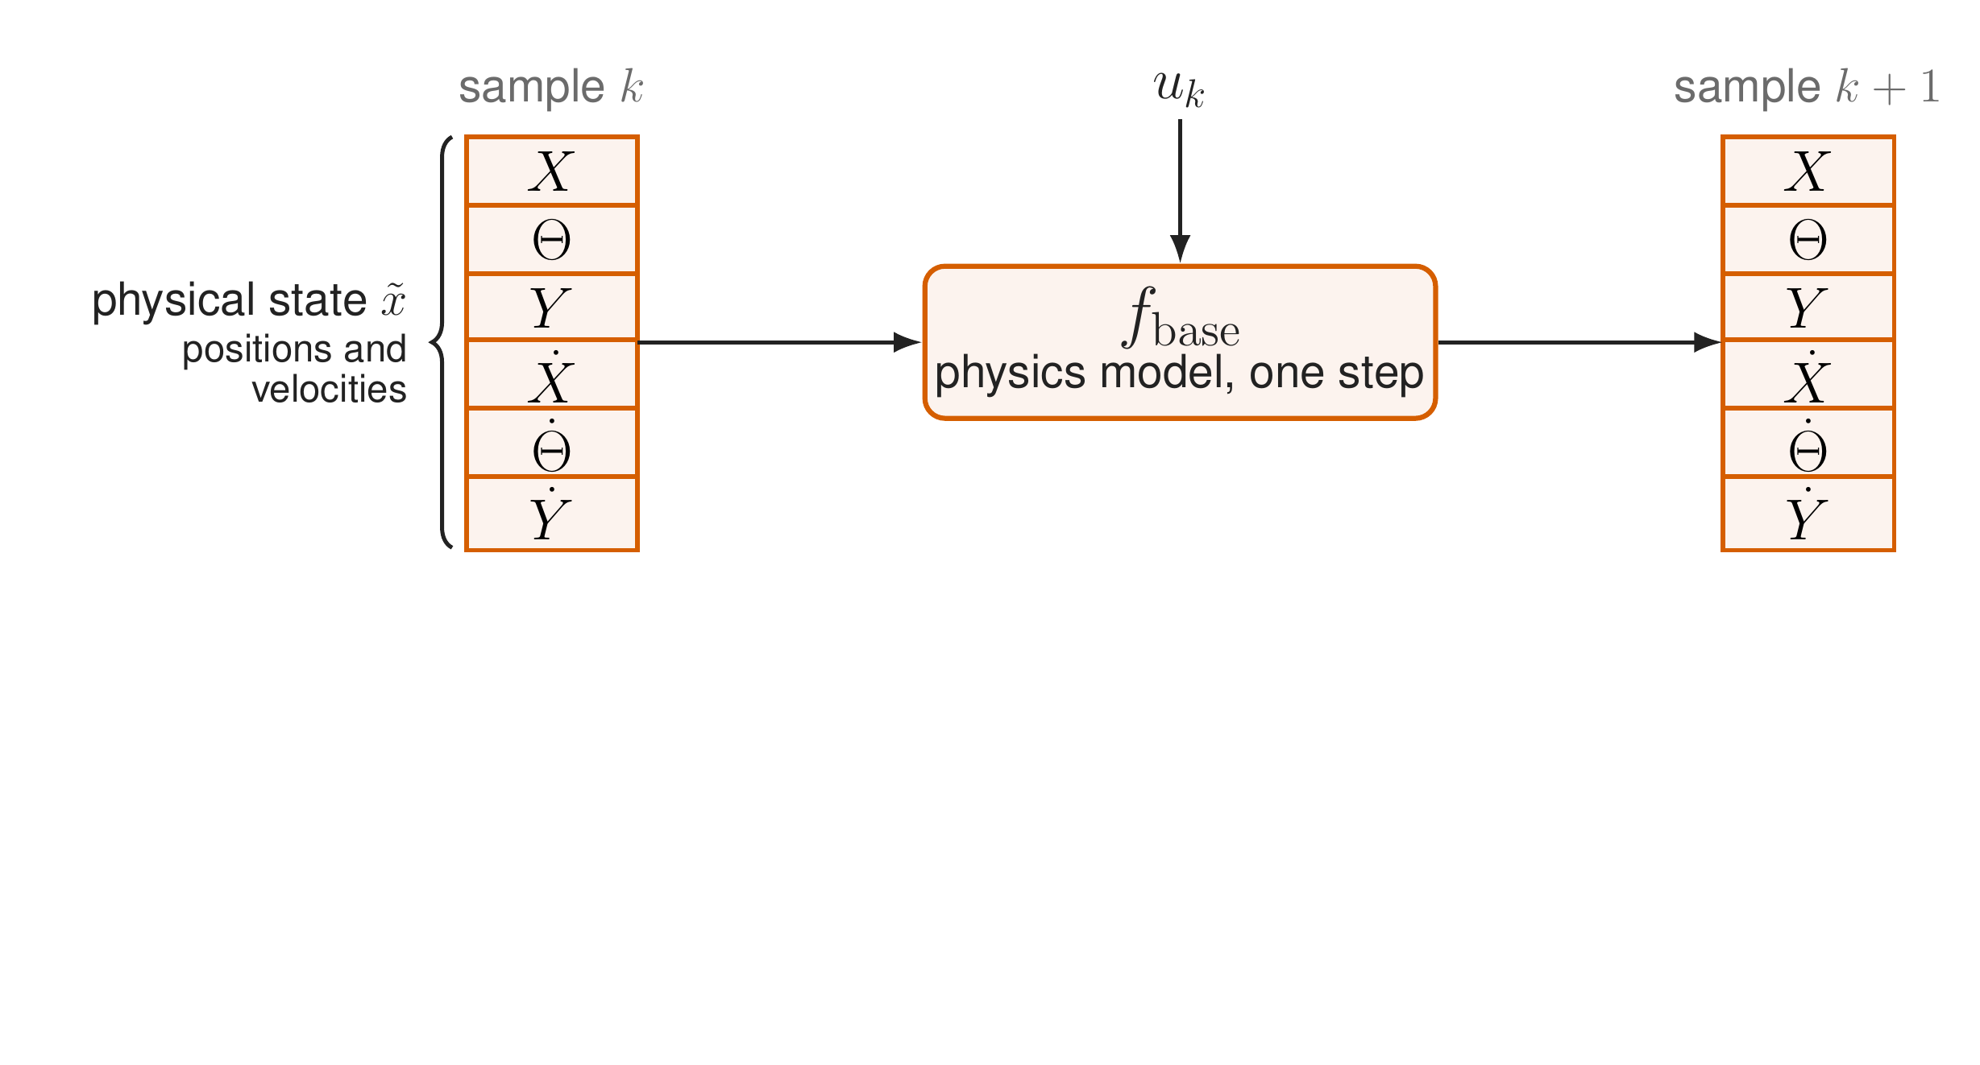
The physics model predicts one sample ahead
10
Interpretable model augmentation | Dirk van den Berg
Notes:
Now the method. We work in discrete time. At sample k the physical state x tilde holds the three positions and three velocities. [click] The physics model, f base, takes that state and the motor forces u k, [click] and predicts the state one sample later. Repeating this step gives a simulation.

Slide 11
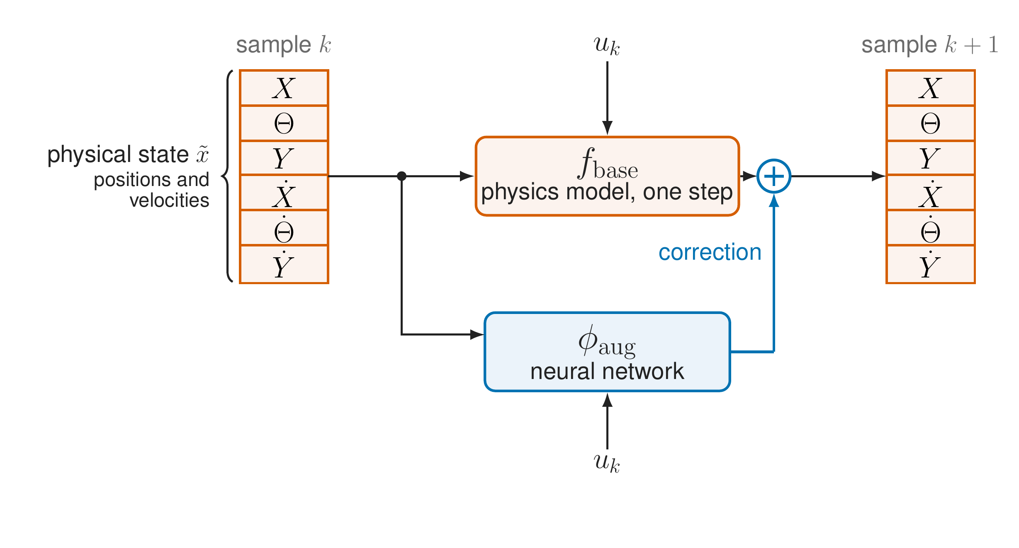
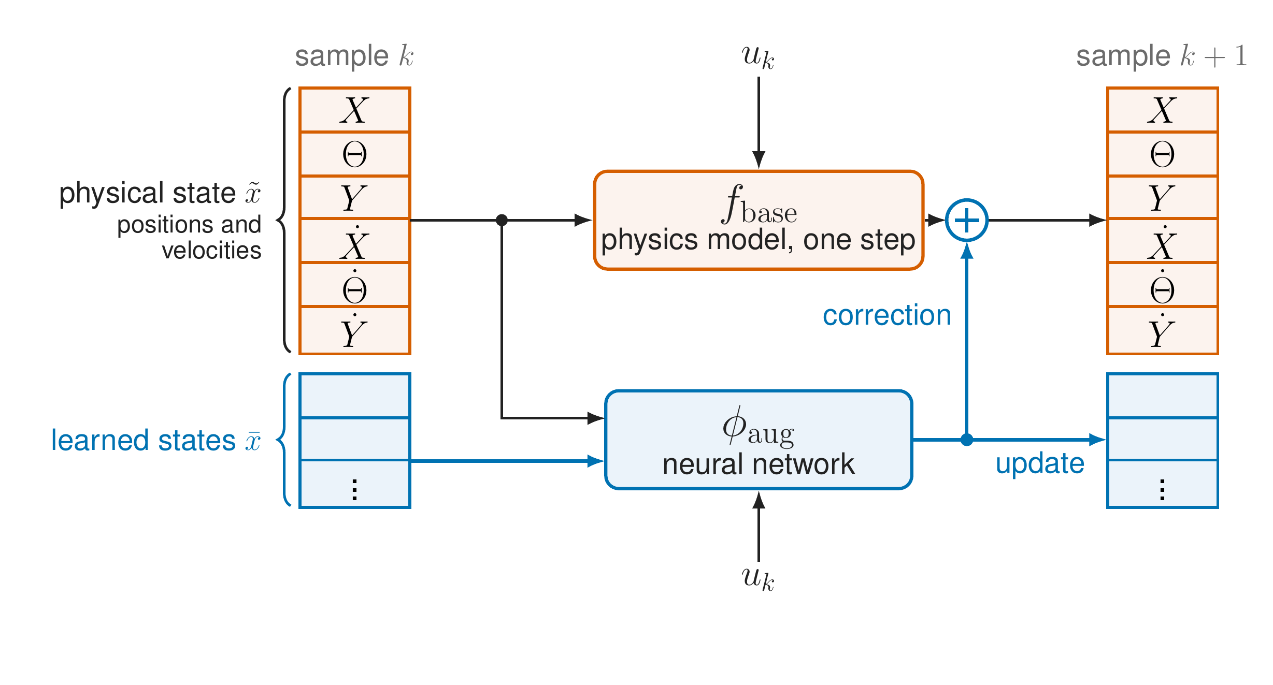
Augmentation: a network corrects each step
11
Interpretable model augmentation | Dirk van den Berg
Notes:
Augmentation adds a neural network, phi aug. [click] It sees the same state and the same input u k, and its output is added as a correction to the physics model's next state. At the start of training this correction is zero, so we start exactly at the physics model. [click] A correction of the physical state alone cannot represent dynamics that need extra states, like the hidden resonance. So the network also gets states of its own, x bar, the learned states, which it updates every step. That is how the model can grow from six to more states.

Slide 12
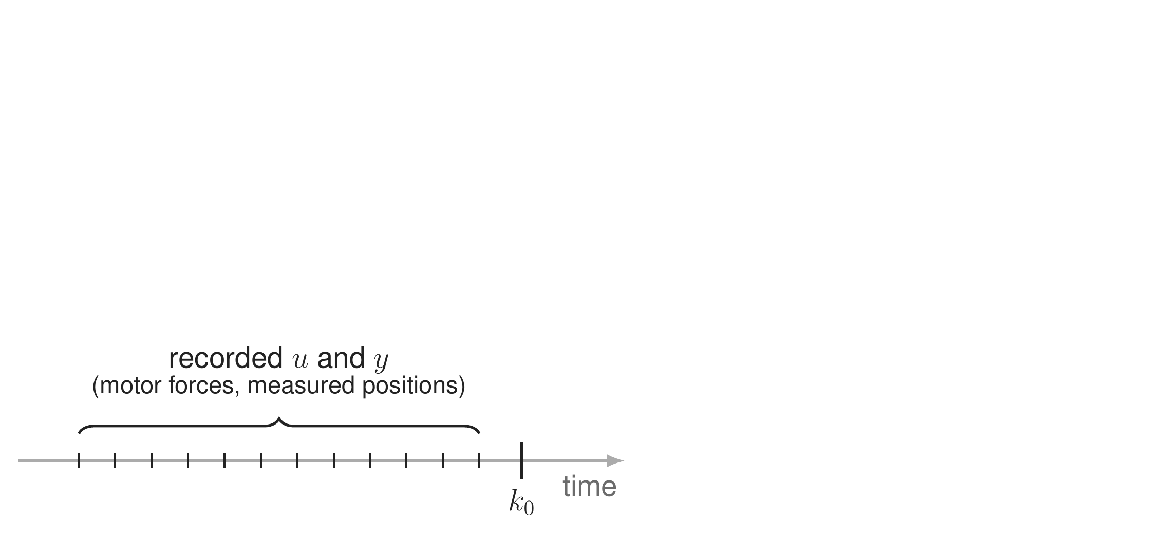
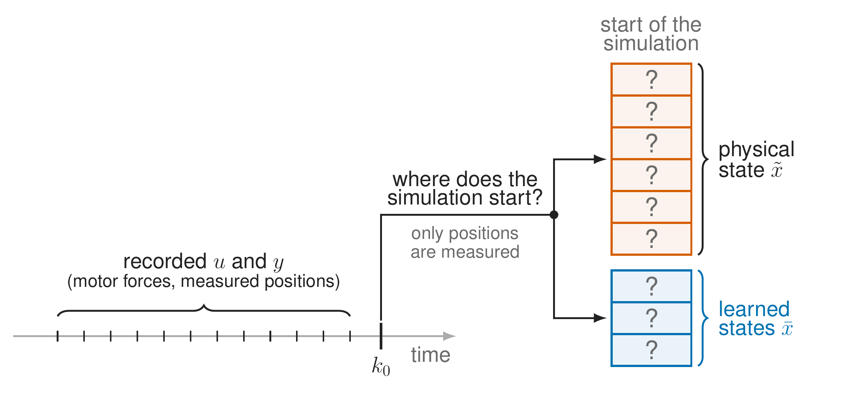
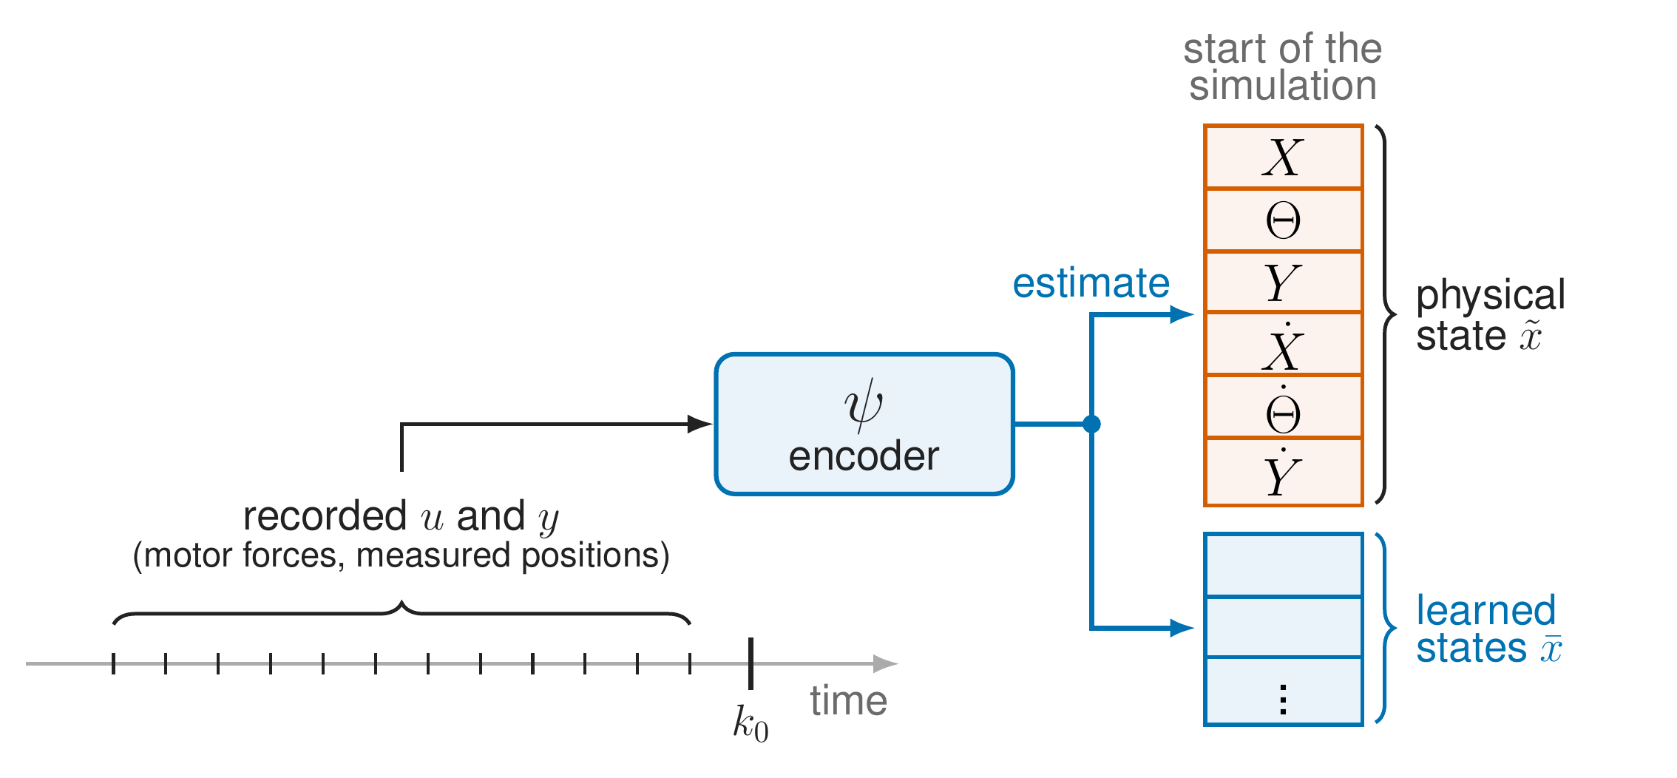
The encoder estimates where the simulation starts
12
Interpretable model augmentation | Dirk van den Berg
Notes:
To simulate, we need a starting state. [click] But only positions are measured: velocities are not, and the learned states are not measured at all, they have no physical meaning. [click] So an encoder, psi, estimates the start state, physical and learned, from a short window of recorded inputs and outputs before the start. The encoder is trained together with the network.

Slide 13
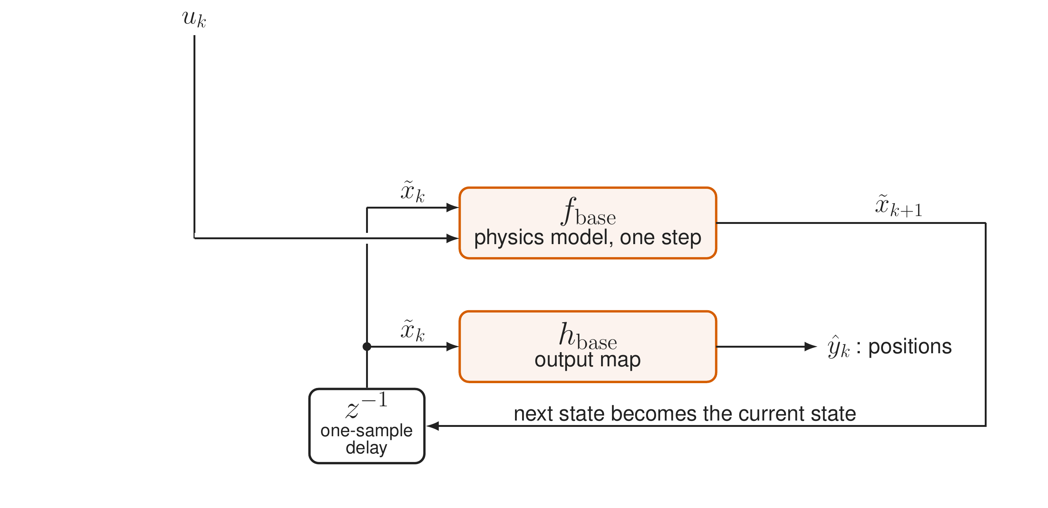
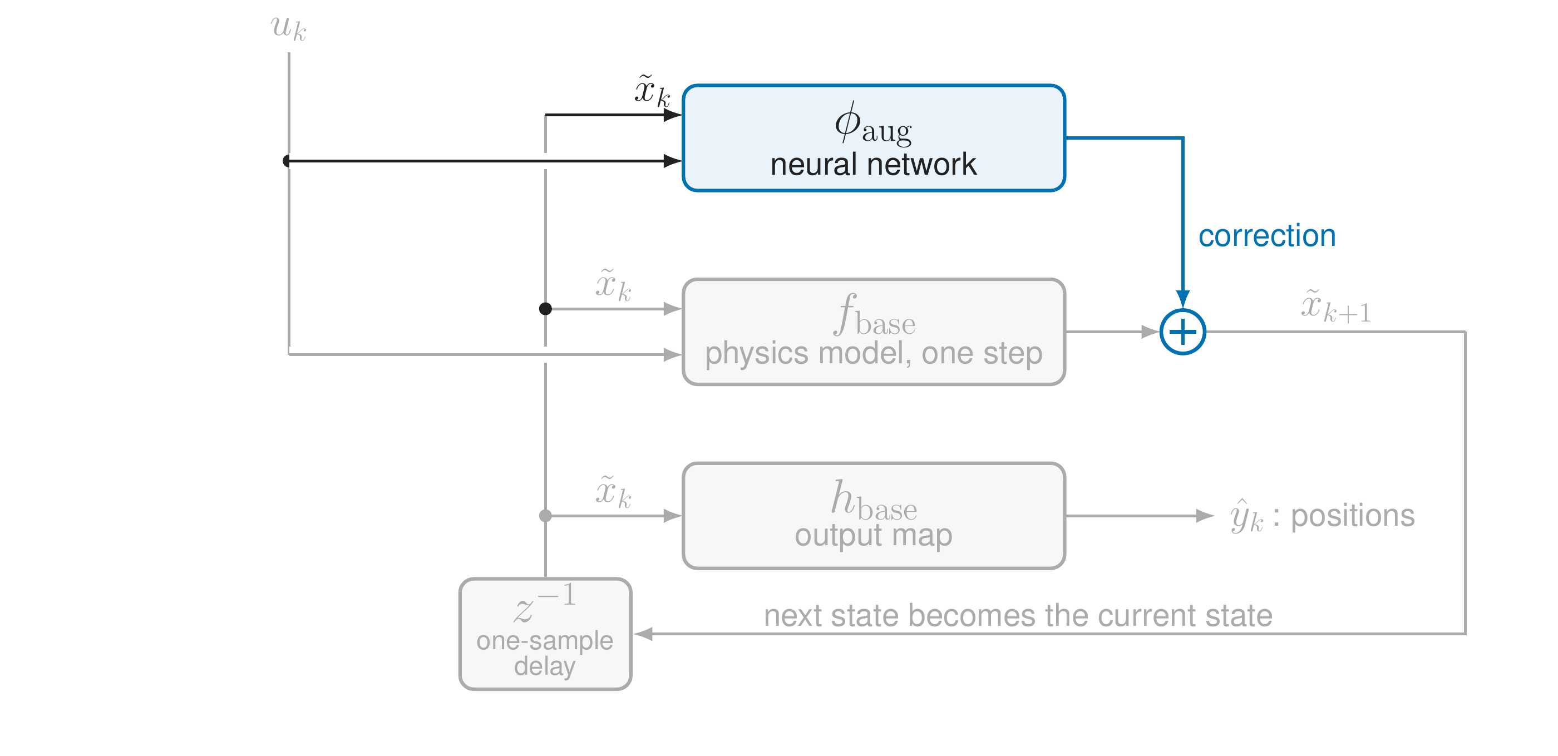
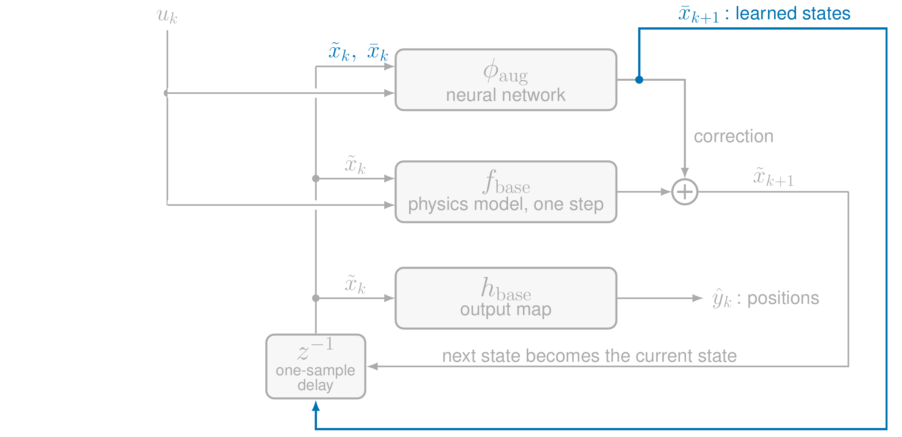
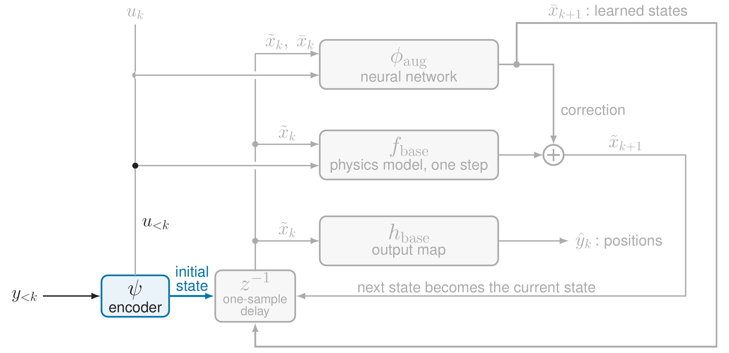
Putting it together
13
Interpretable model augmentation | Dirk van den Berg
Notes:
Here are the same pieces in one diagram. The physics model steps the state forward, the output map gives the positions, and the delay feeds the next state back as the current state. [click] The network adds its correction to the physical state update. [click] The learned states run in their own loop through the network. [click] And the encoder gives the initial state of both. Everything is trained end to end on simulated trajectories of the training records.

Slide 14
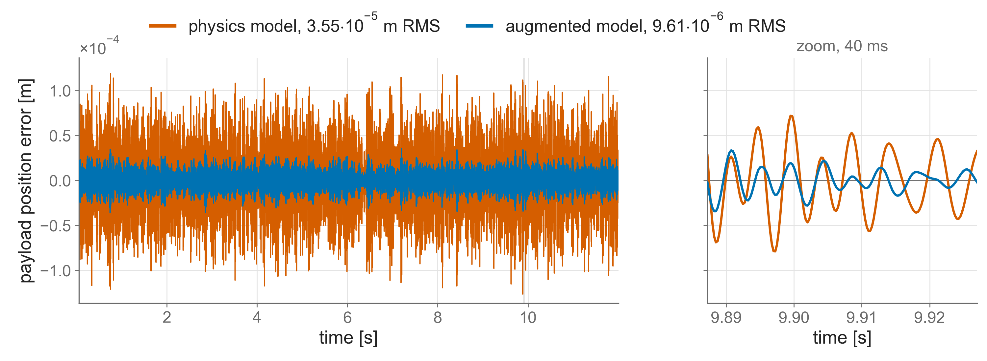
On held-out data the error drops 3.6 times
RMS over 4 held-out records and 3 positions: 2.06·10⁻⁵ m to 5.77·10⁻⁶ m
lower than the physics model on every held-out record
14
Noiseless simulation, no friction, one training run per setting, earlier pipeline version.
Notes:
Does it work? We validate in closed loop, with the known controller, as the machine runs; the details are in the backup. The criterion: on the held-out records, the augmented model must have a lower error than the physics model, on every record. The figure shows one held-out record, the payload axis, where the resonance acts: physics model in orange, augmented model in blue, and a 40 millisecond zoom on the right. [click] Over all four held-out records and three positions, the error drops from 2.06 times ten to the minus five metres to 5.77 times ten to the minus six: 3.6 times lower. [click] And it is lower on every record, so the criterion is met. If we switch off the update of the learned states, the error goes back up to 1.17 times ten to the minus five, so a large part of the gain comes from the learned dynamics.

Slide 15
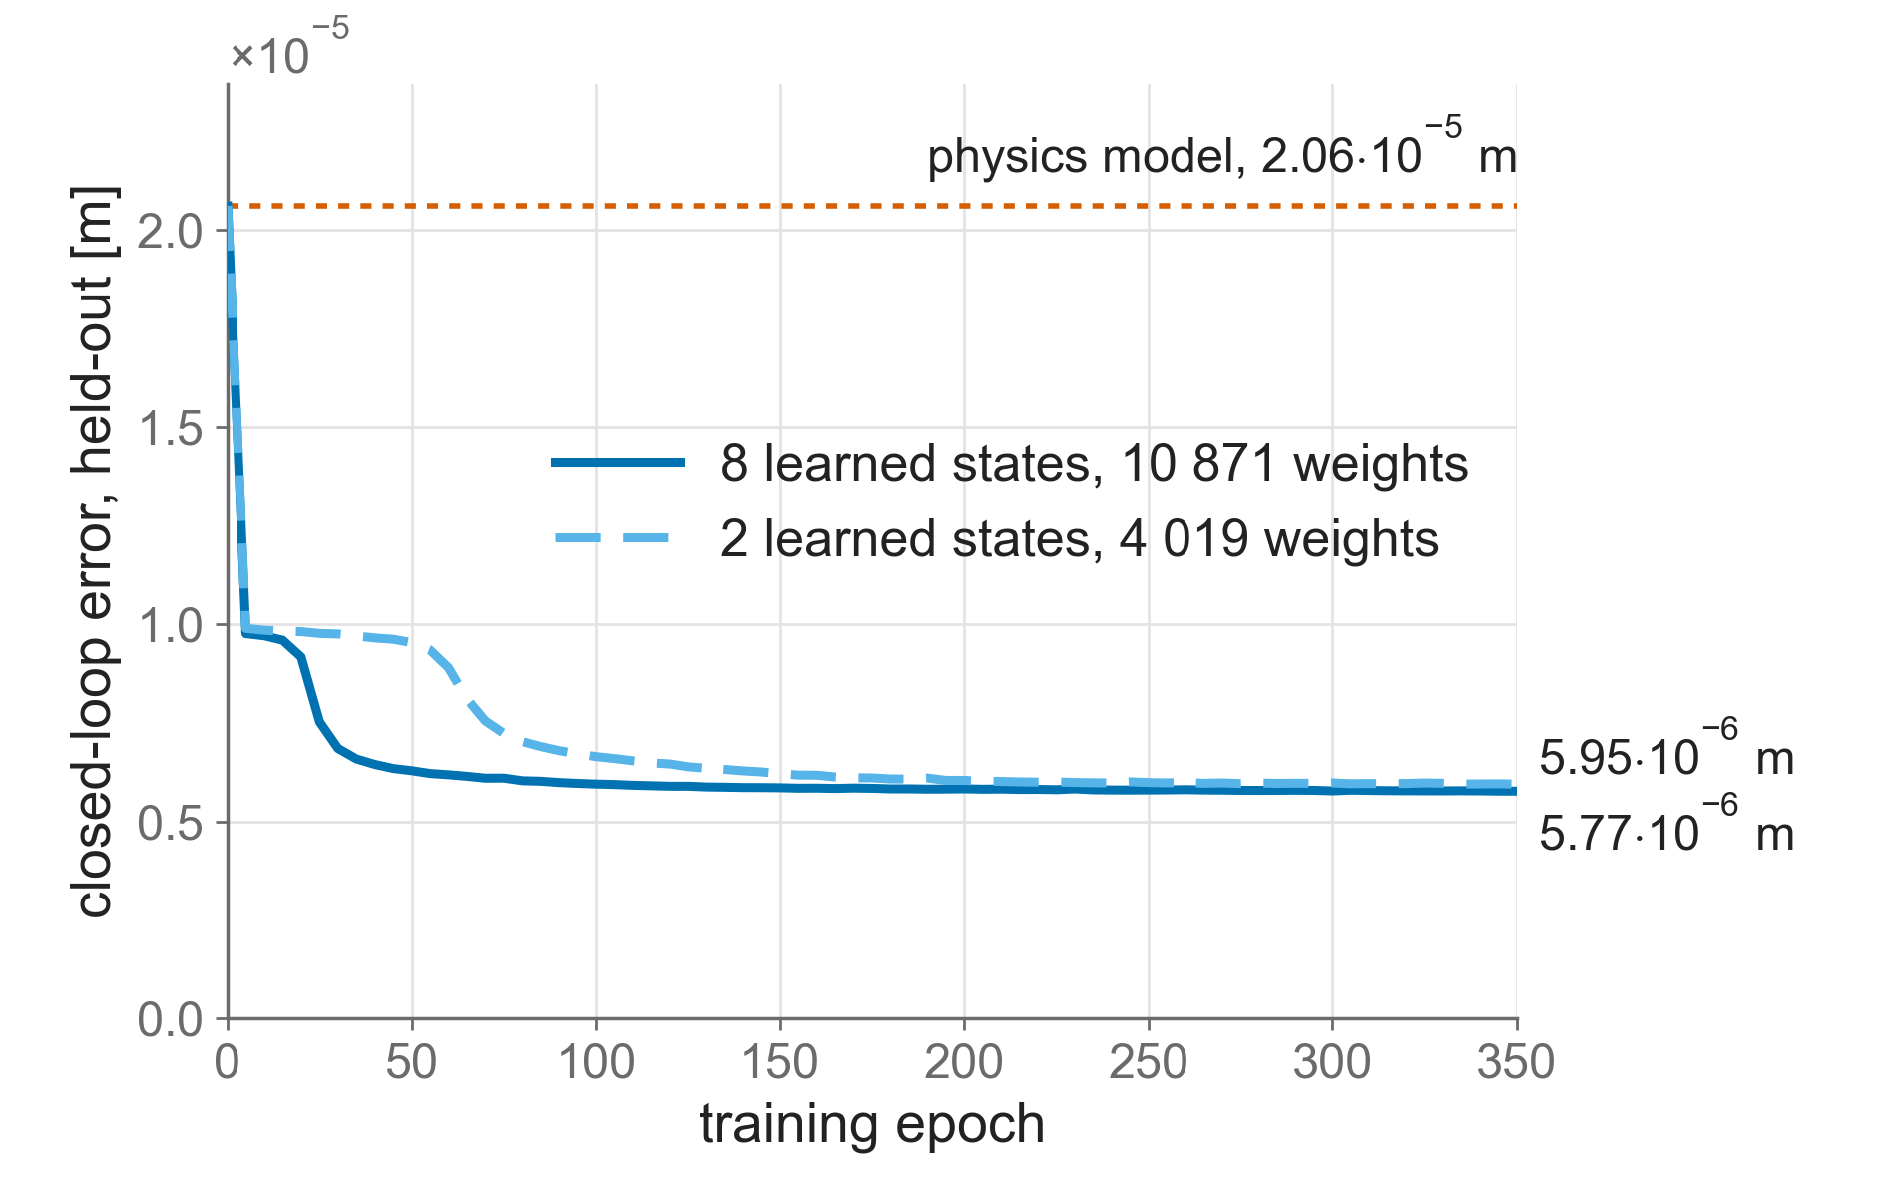
A small learned block nearly suffices
2.7 times the weights buys 3 %
15
Noiseless simulation, no friction, one training run per setting, earlier pipeline version.
Notes:
How large must the learned block be? Eight learned states against two, which is exactly the number of states the physics model misses. Both start at the physics model and end close together: 5.95 against 5.77 times ten to the minus six metres. [click] The large block has 2.7 times the weights and is only 3 % better, so block size is not what limits the accuracy here. One training run each, so 3 % is within what another run could change.

Slide 16
Now: the physical parameters
So far the physical parameters were fixed.
What happens if we train them together with the network?
16
Interpretable model augmentation | Dirk van den Berg
Notes:
So the model is accurate. But up to now the physical parameters were fixed at their true values, which in practice we do not know. [click] So what happens if we train the physical parameters together with the network? This is where interpretability comes in.

Slide 17
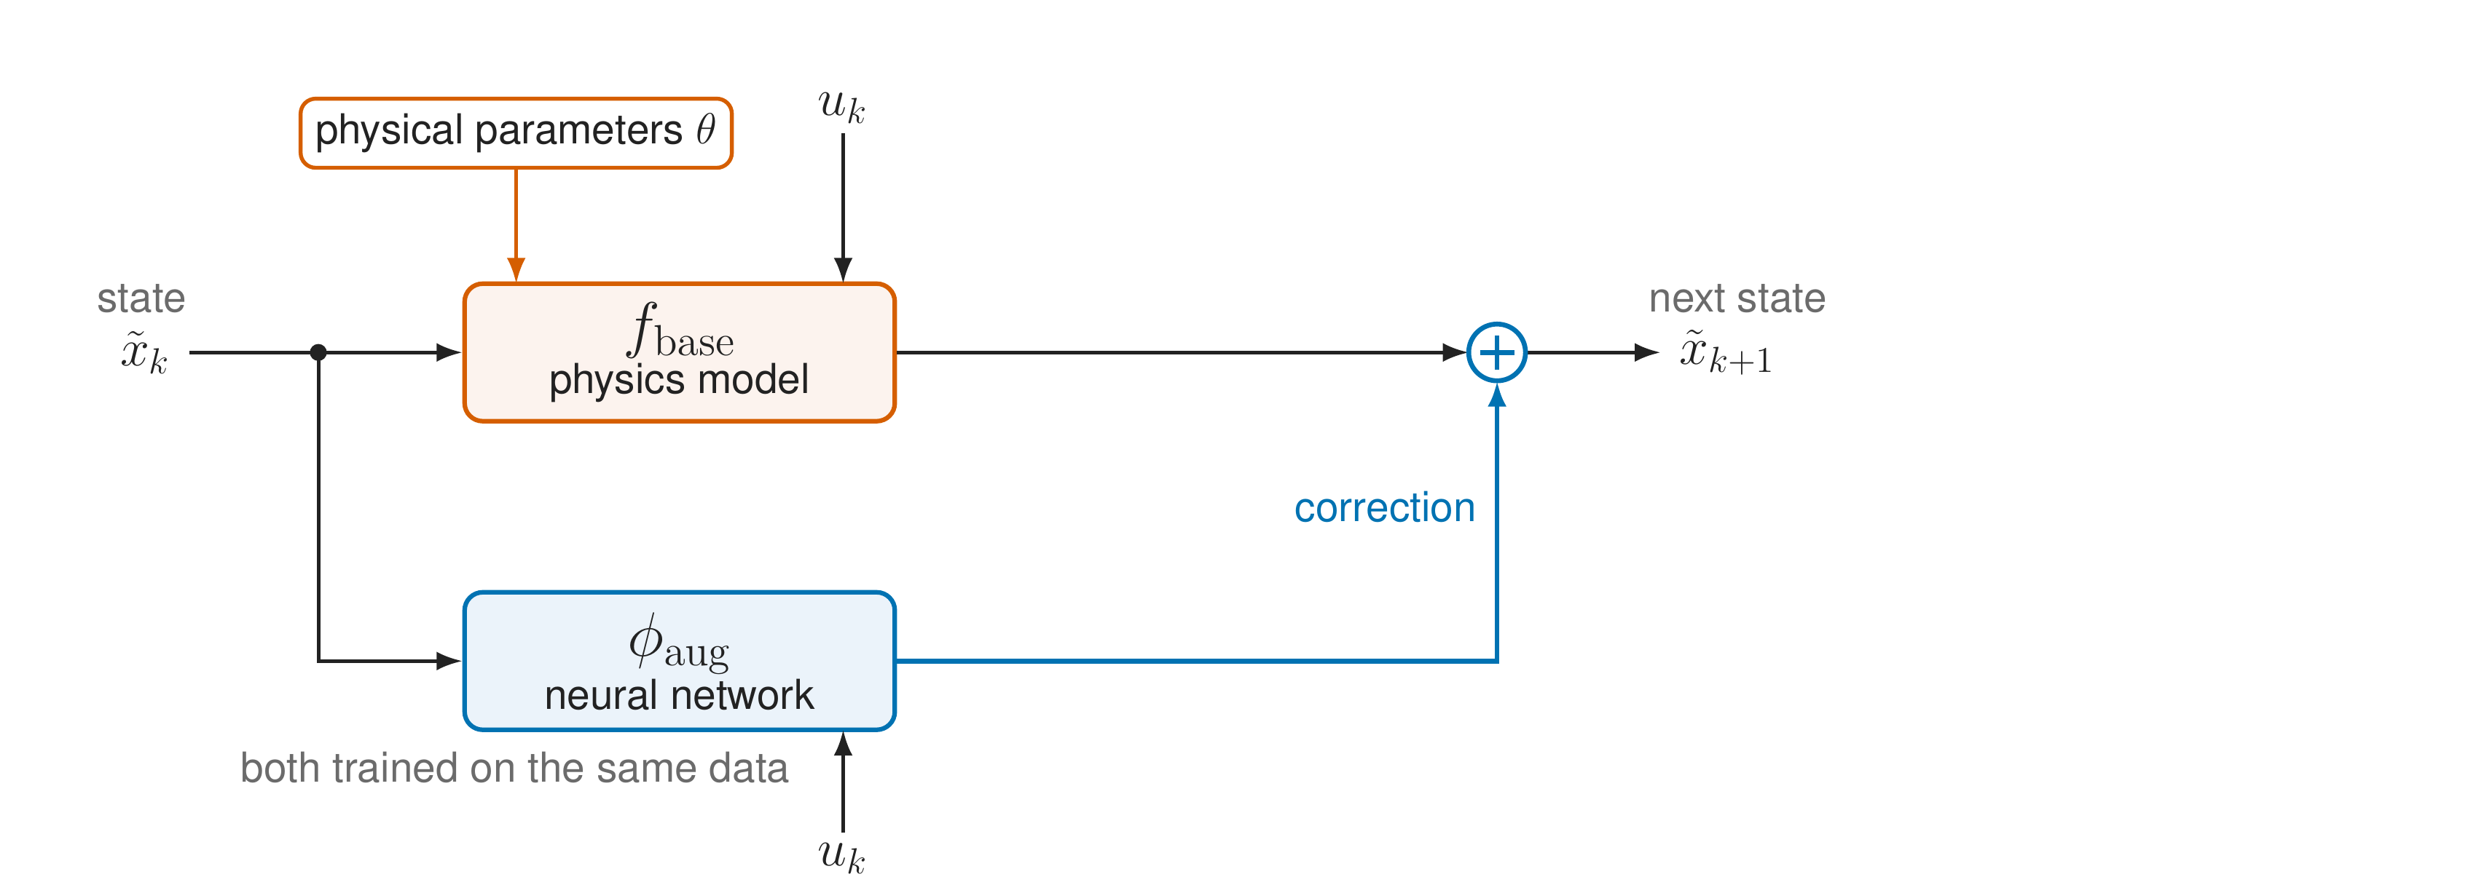
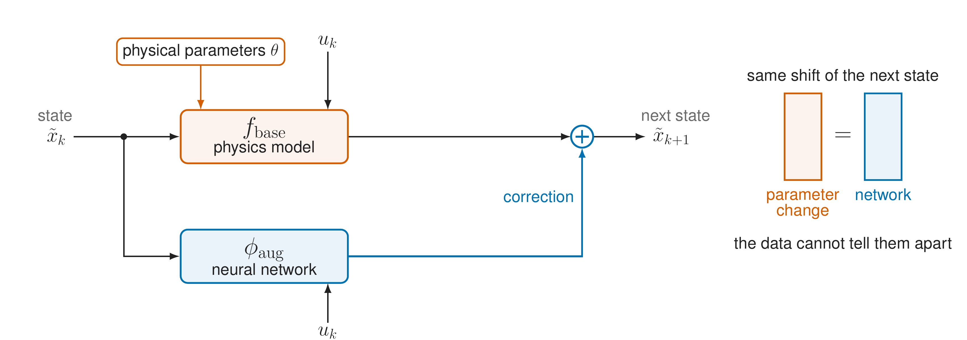
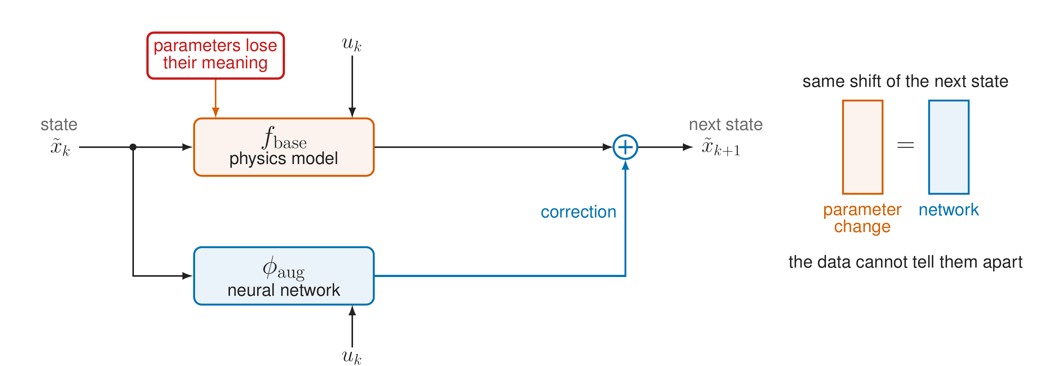
Trained together, the network can take over
17
Interpretable model augmentation | Dirk van den Berg
Notes:
Here is the augmented update again, now with the physical parameters theta shown, and both trained on the same data. [click] A change of a parameter shifts the next state in a certain way. The network can produce exactly the same shift. From the data alone, the two cannot be told apart. [click] So the network can take over part of the job of the parameters, or cancel an error in them. The fit is still good, but the parameters no longer mean mass, stiffness and damping. We call this negation. For health monitoring that is exactly what we cannot have.

Slide 18
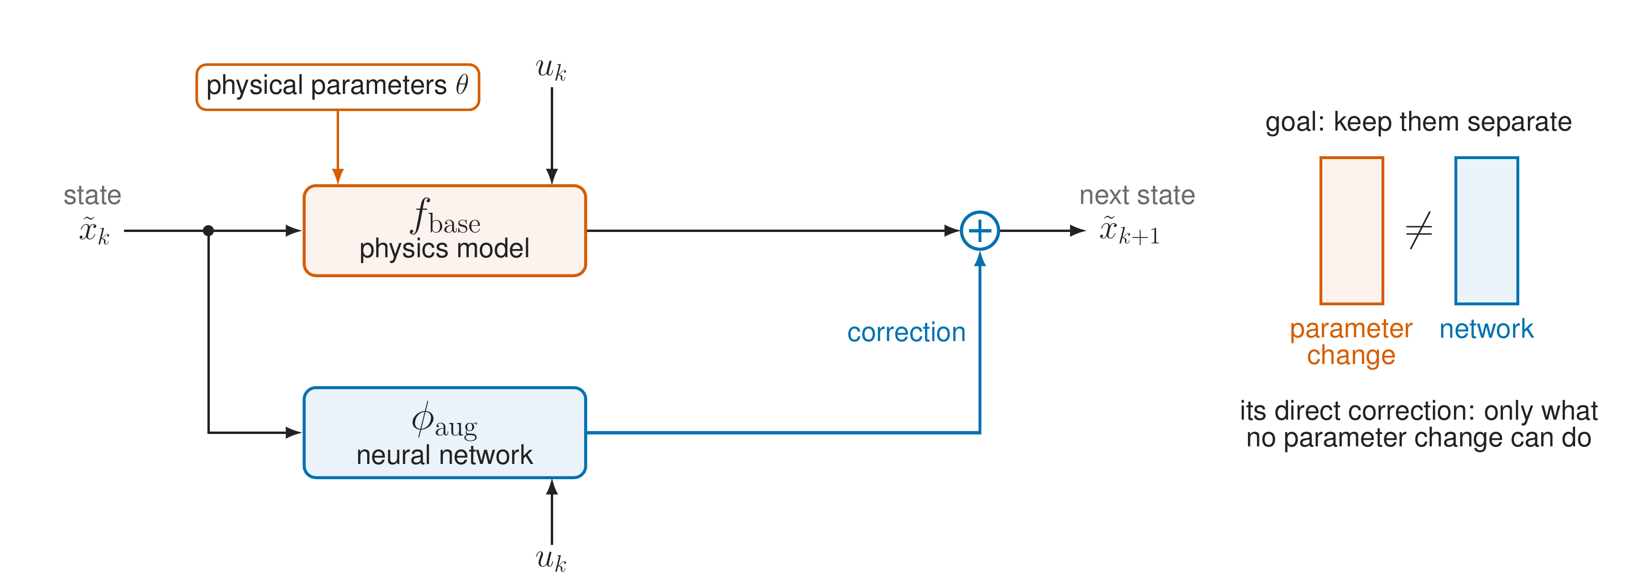
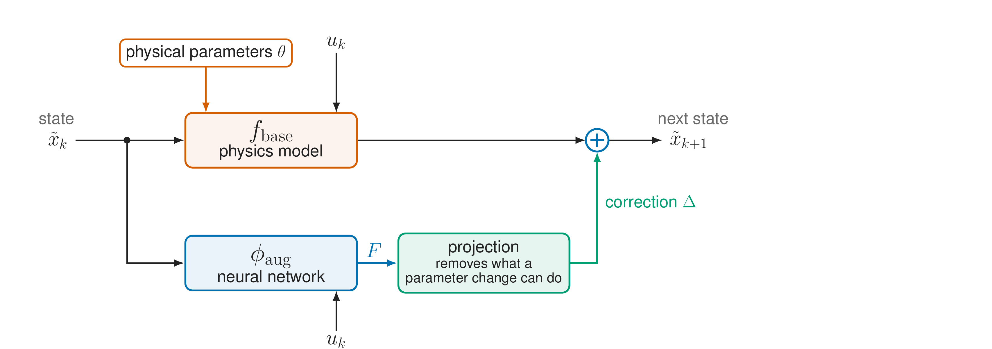
Goal: keep the network out of the parameters' job
18
Interpretable model augmentation | Dirk van den Berg
Notes:
So the goal is to keep them separate: the network's direct correction should only do what no parameter change can do. [click] We do that with a projection between the network and the state update. The network gives its output F; the projection removes the part a parameter change could also produce; what is left, the correction Delta, is what goes into the model.

Slide 19
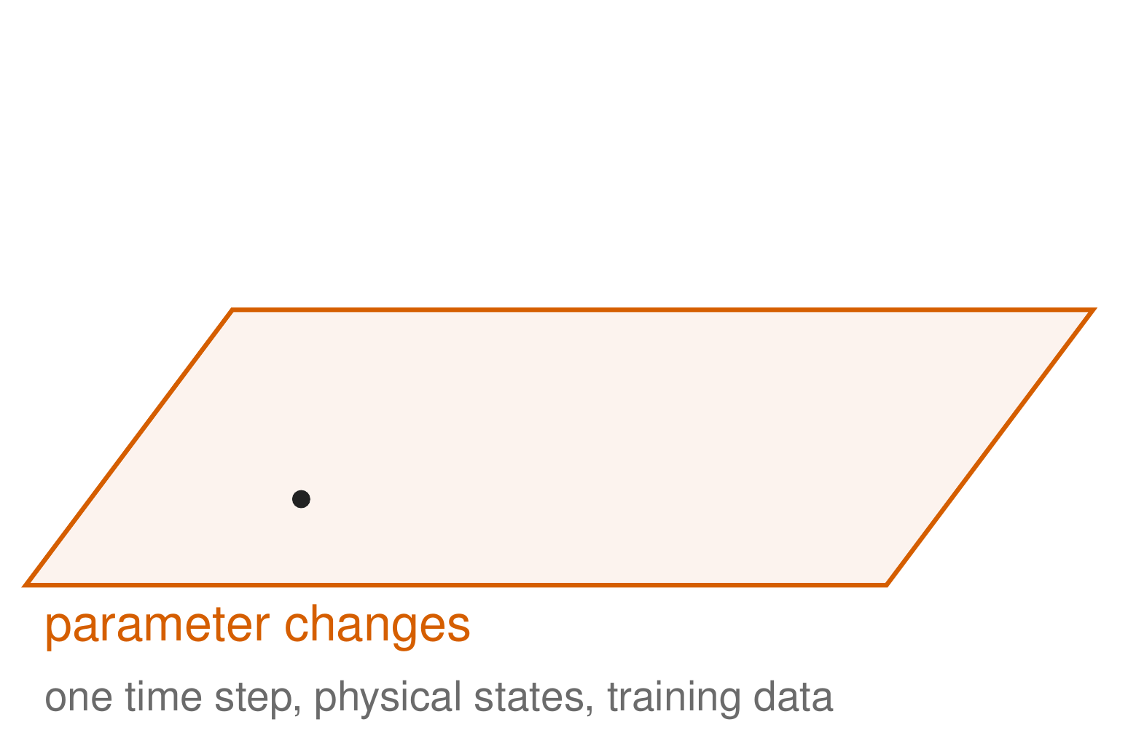
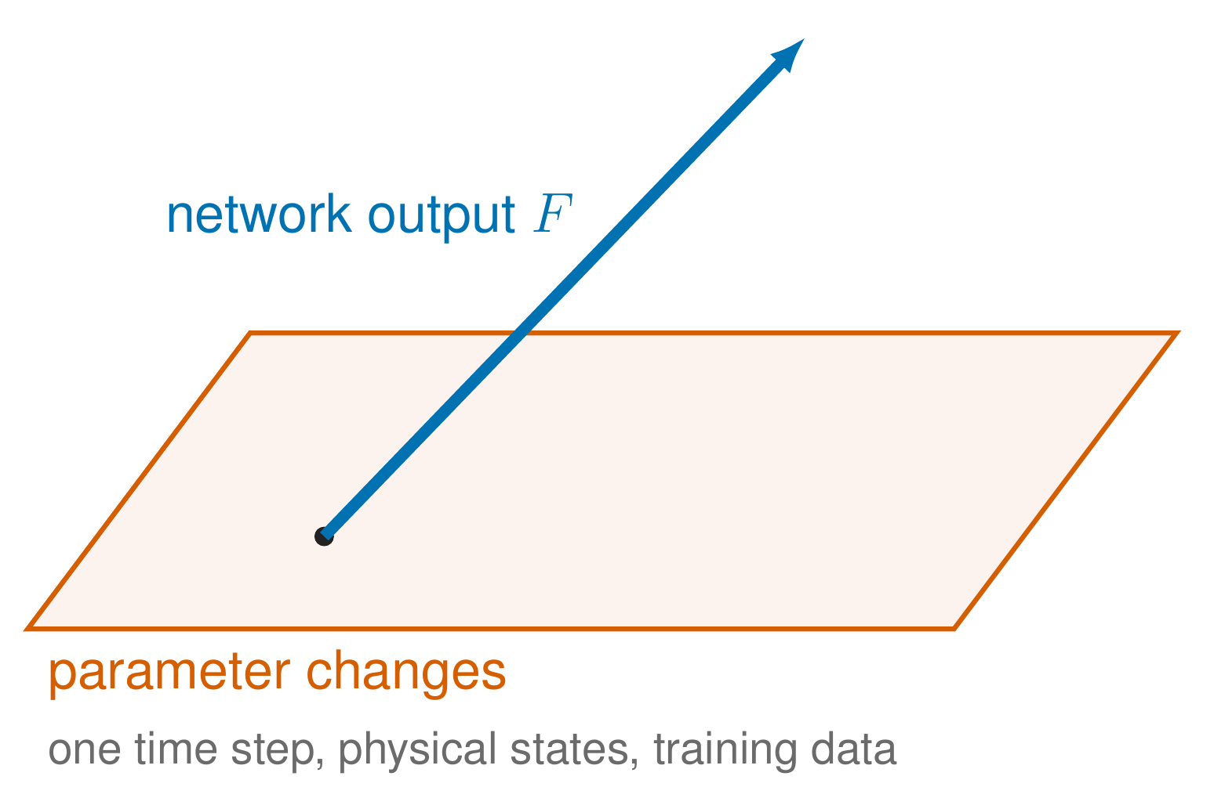
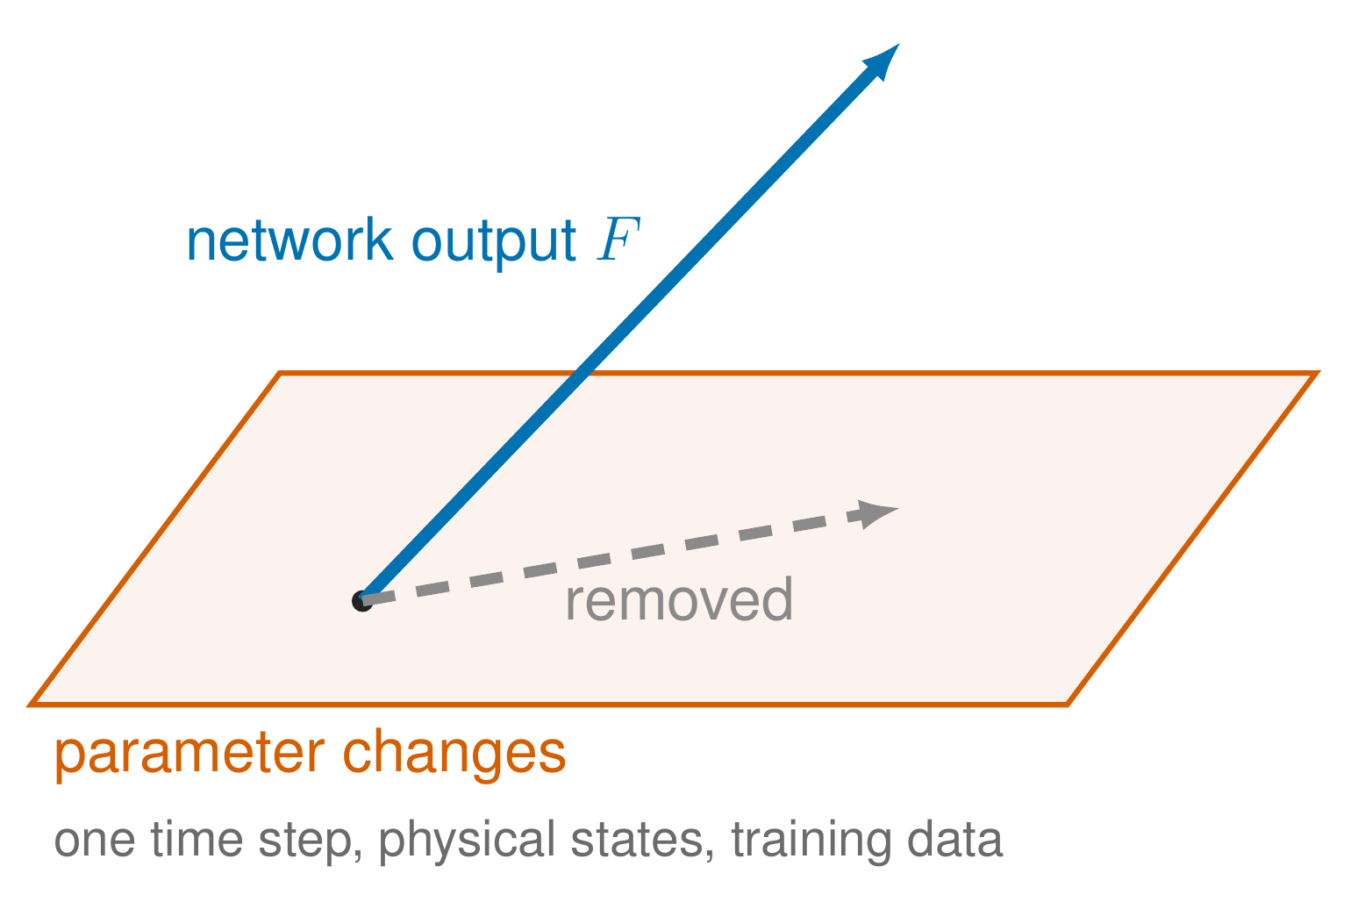
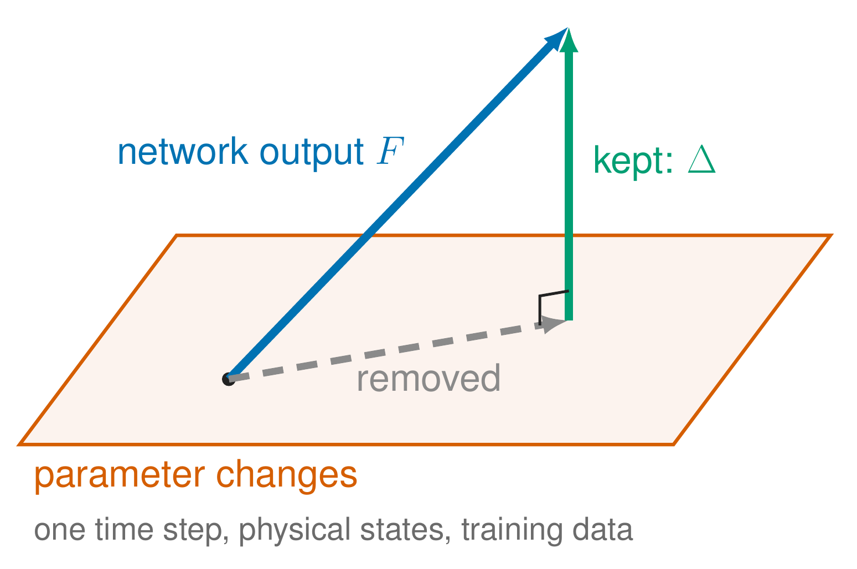
The projection, as a picture
19
Interpretable model augmentation | Dirk van den Berg
Notes:
As a picture. The orange plane stands for everything a change of the physical parameters can do to the next state; in reality it has ten directions, one per parameter combination, and it is built on the training data. [click] The network output F is the blue arrow. [click] The part of F that lies in the plane, a parameter change could also have done: that part is removed. [click] What is kept, Delta, is at a right angle to the plane. So the network's direct correction to the physical states is kept out of the parameter directions on the training data. The directions are rebuilt every epoch, and the projection is fitted every update, so it is part of the model, not a weight to tune. If asked: this holds per time step; on a full simulated trajectory the effects of earlier steps and the learned states are not projected.

Slide 20
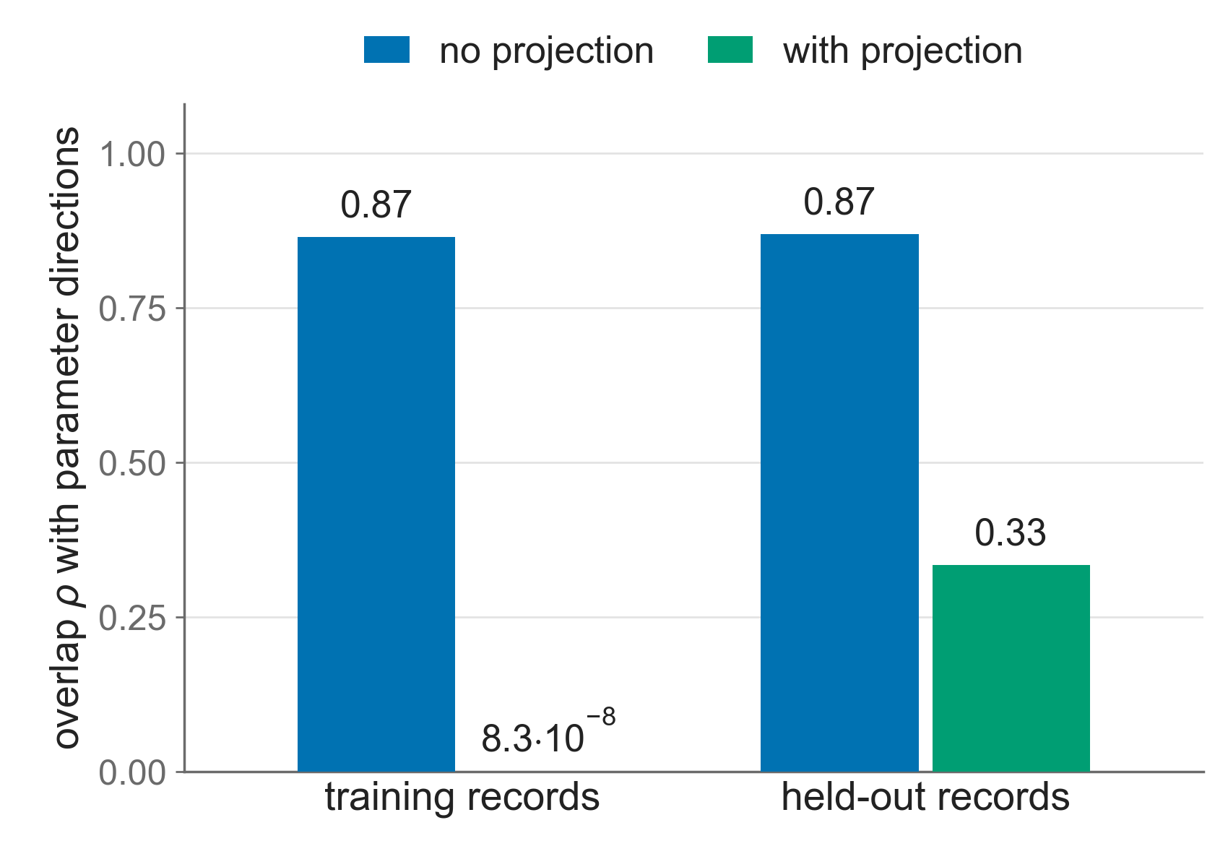
Overlap removed on training data, reduced on held-out data
overlap ρ: share of the correction a parameter change could reproduce
20
Noiseless simulation, no friction, one training run per setting, earlier pipeline version.
Notes:
We measure the overlap rho: the share of the correction that a parameter change could reproduce, zero meaning none. Without projection it is 0.87: most of what the network does, the parameters could have done. With projection, on the training records, it is 8.3 times ten to the minus eight, removed, as expected, because that is where the projection is built. On held-out records it drops from 0.87 to 0.33: the projection is built on the training data, so on new trajectories part of the overlap returns. If asked: the raw network output of the projected run still has an overlap of 0.92; it is the projection that removes it.

Slide 21
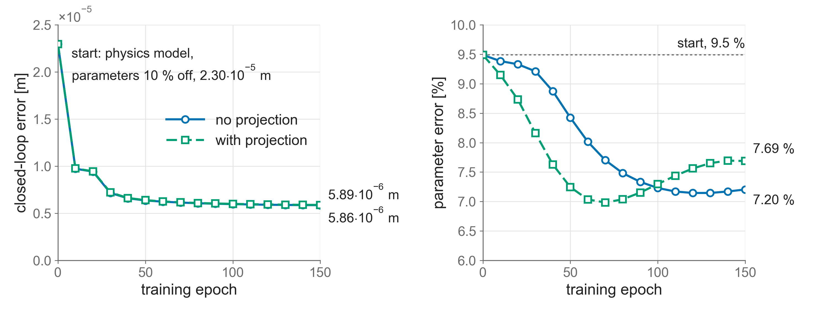
Same fit, but the parameters are not yet recovered
fit: 5.86·10⁻⁶ m without, 5.89·10⁻⁶ m with projection | parameter error: 7.2 % without, 7.7 % with
21
Noiseless simulation, no friction, one training run per setting, earlier pipeline version.
Notes:
Both runs train the network and all ten parameters together, starting with every parameter 10 % off. Left, the fit: both end at the same error, 5.86 and 5.89 times ten to the minus six metres, so the projection costs no accuracy. Right, the parameter error: both improve from 9.5 %, but neither gets close to zero; with projection 7.7 %, without 7.2 %. [click] So keeping the network's direct correction out of the parameter directions is not enough to bring the parameters back. A likely reason, if asked: the projection works per time step on the physical states, while the parameters are judged on full simulated trajectories, where the learned states and earlier corrections still interact with them. That is the open problem for the rest of the thesis.

Slide 22
Conclusion
Augmentation
3.6 times lower closed-loop error on held-out data; a small block nearly suffices
Projection
keeps the network's direct correction out of the parameter directions on training data, at no cost in fit
Open
the physical parameters are not yet recovered
Next
measurement noise, friction, and a black-box comparison
22
Interpretable model augmentation | Dirk van den Berg
Notes:
To conclude. Augmenting the physics model with a network and learned states cuts the closed-loop error on held-out data 3.6 times, and a small block nearly suffices. [click] The projection keeps the network's direct correction out of the parameter directions on the training data, without losing accuracy. [click] But the physical parameters are not yet recovered, so interpretability is only partly solved. [click] Next are measurement noise and friction, and a comparison against a black box model on the same data. All results here are noiseless simulation without friction, one training run per setting, with an earlier version of the pipeline.

Slide 23
Thank you. Questions?
Notes:
Thank you. I am happy to take questions.

Slide 24
Backup
B
Interpretable model augmentation | Dirk van den Berg
Notes:
Backup slides for questions.

Slide 25
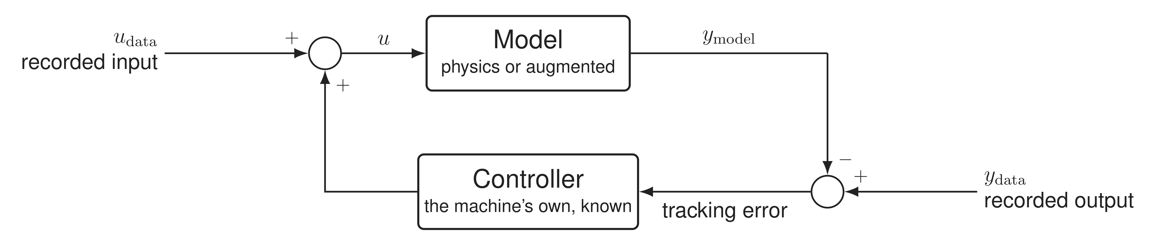
Validation in closed loop
X and Y have no spring to the ground: open loop, a small force error integrates into drift
model input: recorded input plus the controller's response to the model's error
B1
Interpretable model augmentation | Dirk van den Berg
Notes:
Why closed loop? X and Y have no stiffness to the ground, so in an open-loop simulation any small force error integrates twice into a growing position error. The machine always runs under feedback, so we validate the same way: the model gets the recorded input plus the known controller's response to the difference between the recorded output and the model output. The model state is never reset to the data. The augmented model drifts in a long open-loop simulation, which is a real limitation for open-loop use.

Slide 26
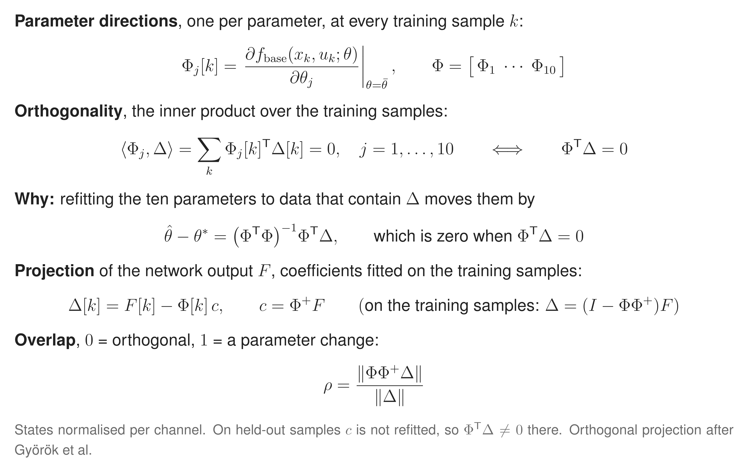
Orthogonality and the projection in formulas
B2
Interpretable model augmentation | Dirk van den Berg
Notes:
The directions are the derivative of the one-step update of the six physical states with respect to the ten parameter combinations, evaluated on the recorded training samples, 671 944 of them, with the learned states set to zero. The projection subtracts from the network's direct correction to the physical states its part in those directions. The coefficients are fitted every optimizer update, and the directions are rebuilt every epoch. On held-out data the training coefficients are reused, which is why the overlap there is 0.33 and not zero. Rho is the norm of the part in the parameter directions over the norm of the correction. The reference value rho star is 0.20.

Slide 27
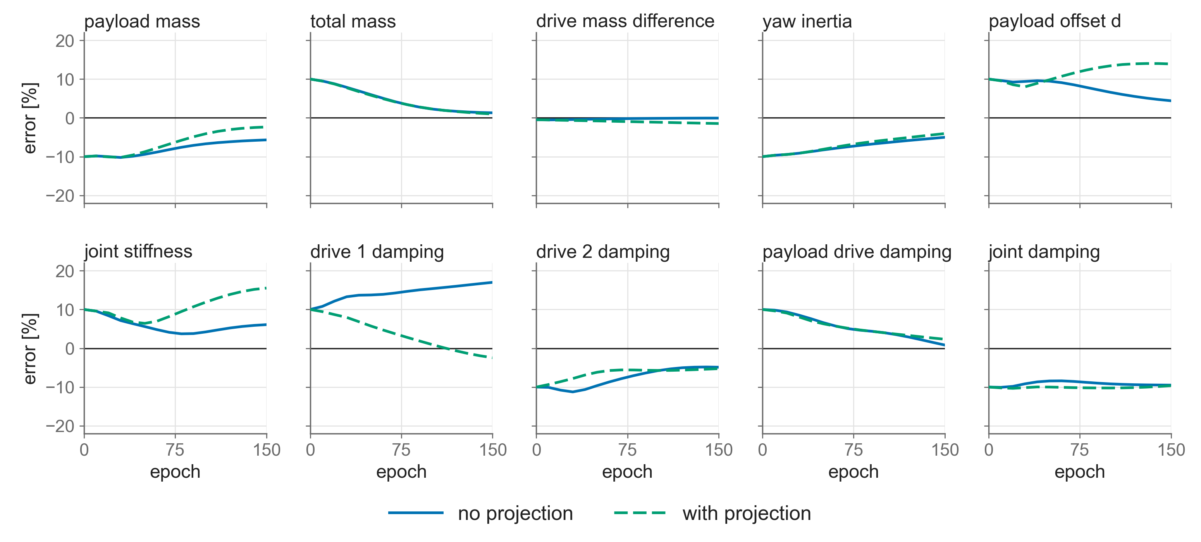
All ten parameters, with and without projection
B3
Noiseless simulation, no friction, one training run per setting, earlier pipeline version.
Notes:
All ten parameter combinations. The total mass, yaw inertia and payload drive damping move towards the truth in both runs. The joint damping does not move at all. Without projection one drive damping drifts to 17 %; with projection the joint stiffness and the payload offset drift to about 15 %. So the projection redistributes the error over the parameters rather than removing it.

Slide 28
Settings of the four training runs
 | 8-state block | 2-state block | no projection | with projection
Learned states | 8 | 2 | 8 | 8
Network | 3 layers × 24 | 2 layers × 16 | 3 layers × 24 | 3 layers × 24
Learned weights | 10 871 | 4 019 | 10 871 | 10 871
Encoder window | 29 samples | 17 samples | 29 samples | 29 samples
Training epochs | 350 | 350 | 150 | 150
Physical parameters trained | no | no | yes, from 10 % off | yes, from 10 % off
Projection | no | no | no | yes
All runs: noiseless simulated data, controller in the loop, 4 kHz, 14 training and 4 held-out records, one training run each.
B4
Interpretable model augmentation | Dirk van den Berg
Notes:
The settings, if needed. The block-size comparison and the projection comparison are separate pairs of runs; within each pair only the listed settings differ.

Slide 29
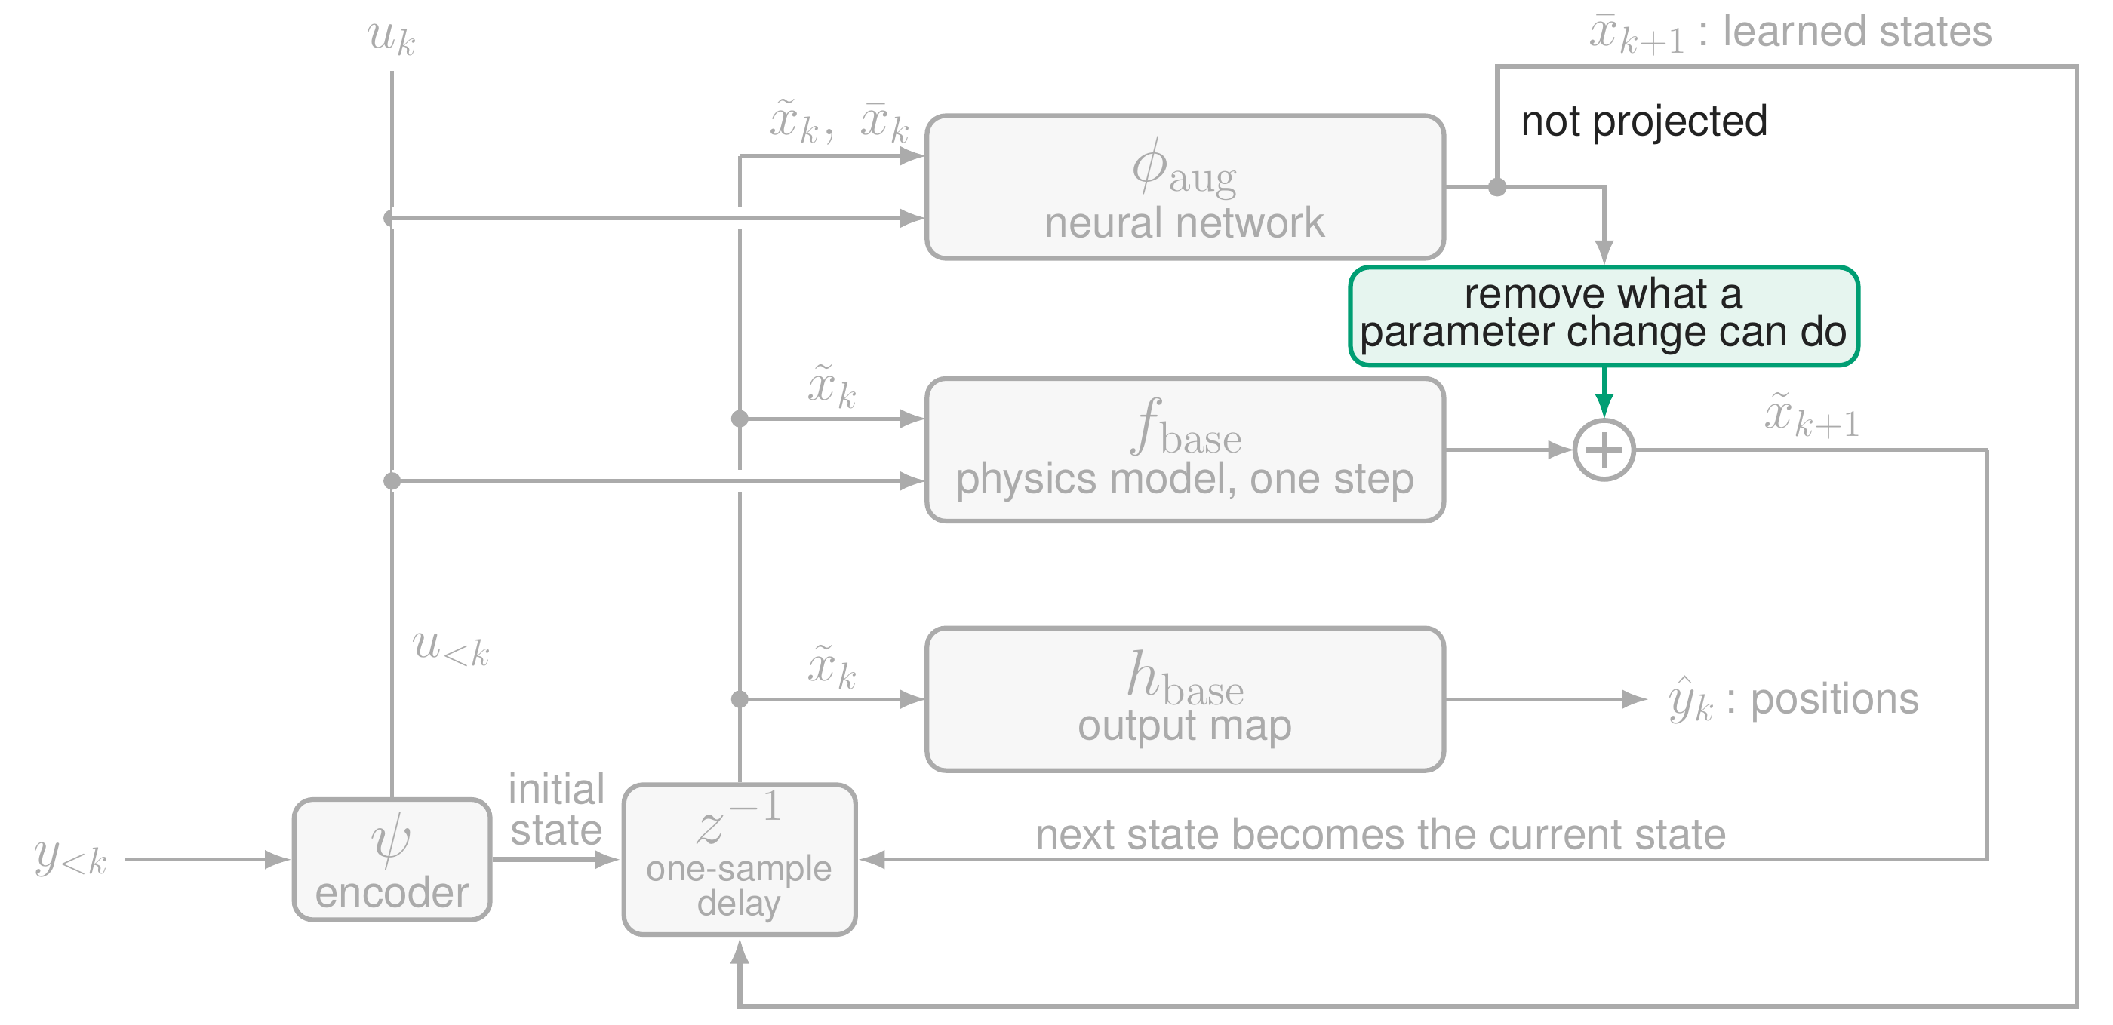
What the projection covers, and what it does not
B5
Interpretable model augmentation | Dirk van den Berg
Notes:
Where the projection sits in the full model. It acts on the network's direct correction to the physical states, inside one state update. The update of the learned states is not projected, and neither are the effects that build up over a simulated trajectory. So the separation holds per time step on the training data, not for a whole trajectory. That is one likely reason the parameters are not recovered.

